Slide 1
Working Toward Making a Perfect Mitre Joint

Slide 2
Two Important Take-aways
1. The mitre you cut is a compound cut – 45⁰ and 90⁰ Each of these cuts must be accurate – dead on accurate – for the joint to work
2. Mitres are really finicky joints. Errors double as you join the legs and those errors compound. If your setup is off by a 1/4⁰ then that error become a 1/2⁰ error. You get around this only by not making any errors.

Slide 3
Mitres are finicky
This mitre head is set
at 45 degrees, precisely

Slide 4
Mitres are finicky
This mitre head is set at 44.75 degrees – ¼ degree off.

Slide 5
Mitres are finicky
This is what ¼ degree off looks like.
This joint doesn’t work. It will not hold and does not pass inspection.
The wood is milled to 2” wide.

Slide 6
Three parts to building a frame
Saw Set Up
Cutting the joint and the legs
Joining
I cannot tell you how to set up and cut mitres on your saw in your shop. What I will do is tell you where I have found mistakes which prevented me from cutting good mitres. And I can tell you how I corrected my mistakes.

Slide 7
Saw Set Up
Key feature on setup is to make sure that everything on the saw is squared up. Exactly squared up.
Nothing is too trivial to overlook at this point. If you checked for square the last time you used your saw, do it again.

Slide 8
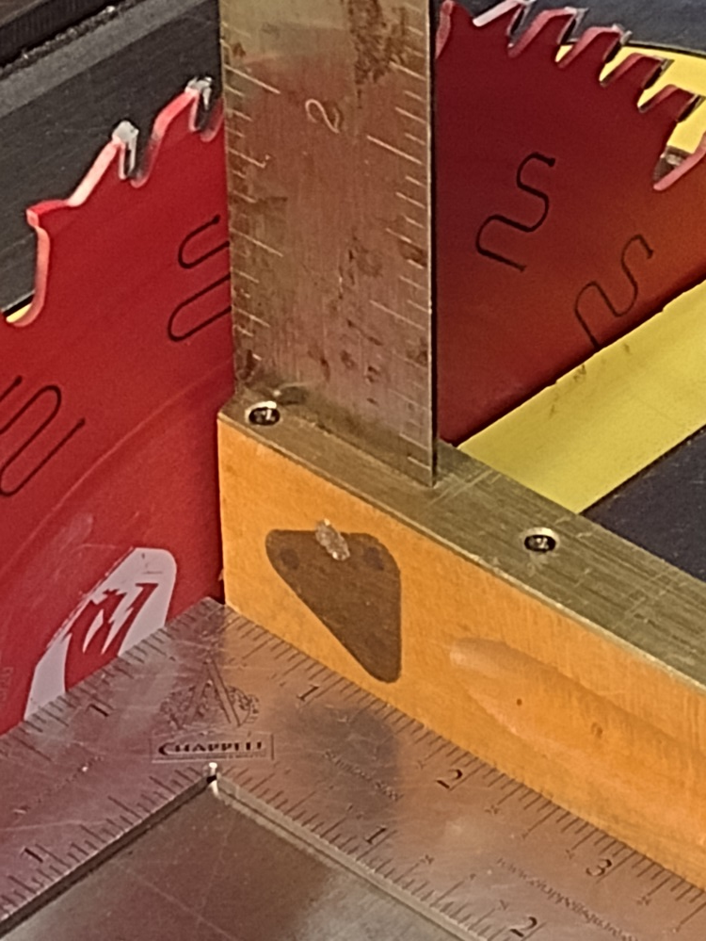
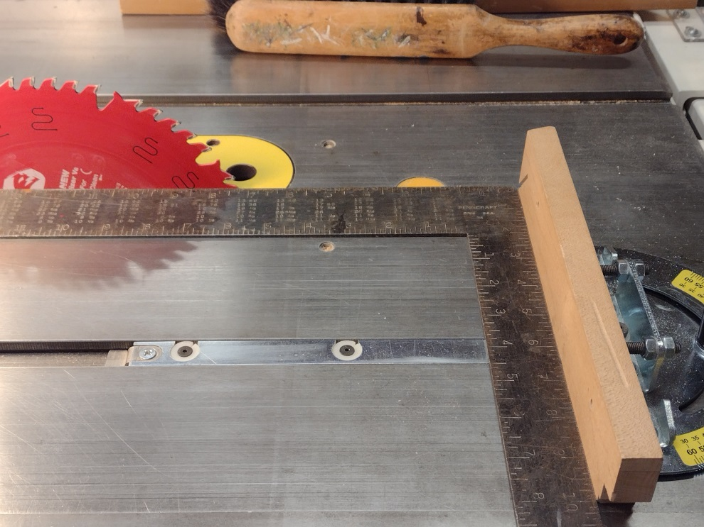
1. Is the throat insert flush?
2. Is your square actually square?
3. How do you check vertical on your blade?
4. If you use a digital angle finder, is it accurate?
5. Double check mitre head and fence for square and parallel to blade
6. Is the face of your mitre head square to the table?
Only accurate to +/- .1⁰

Slide 9
Cutting the Joints and the Legs
The key issues with cutting the joints and the legs are:
Is your blade sharp?
Is your wood straight and true?
Is your 45⁰ dead on?
Are your paired legs precisely the same length?
Mill out more wood than you need. You’ll need it for test cuts

Slide 10
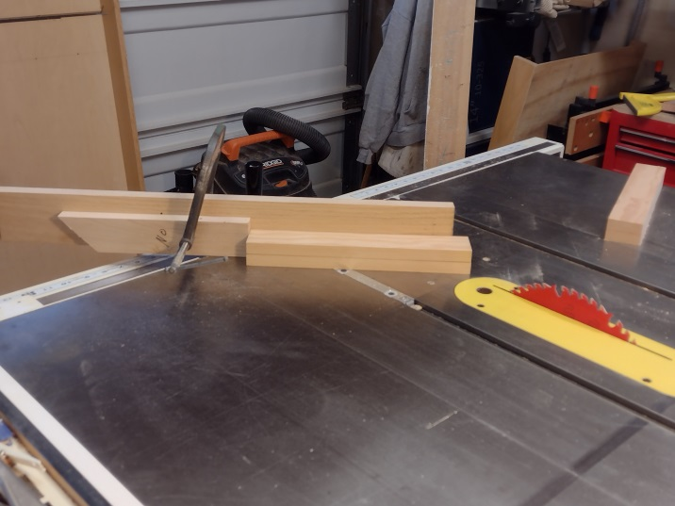
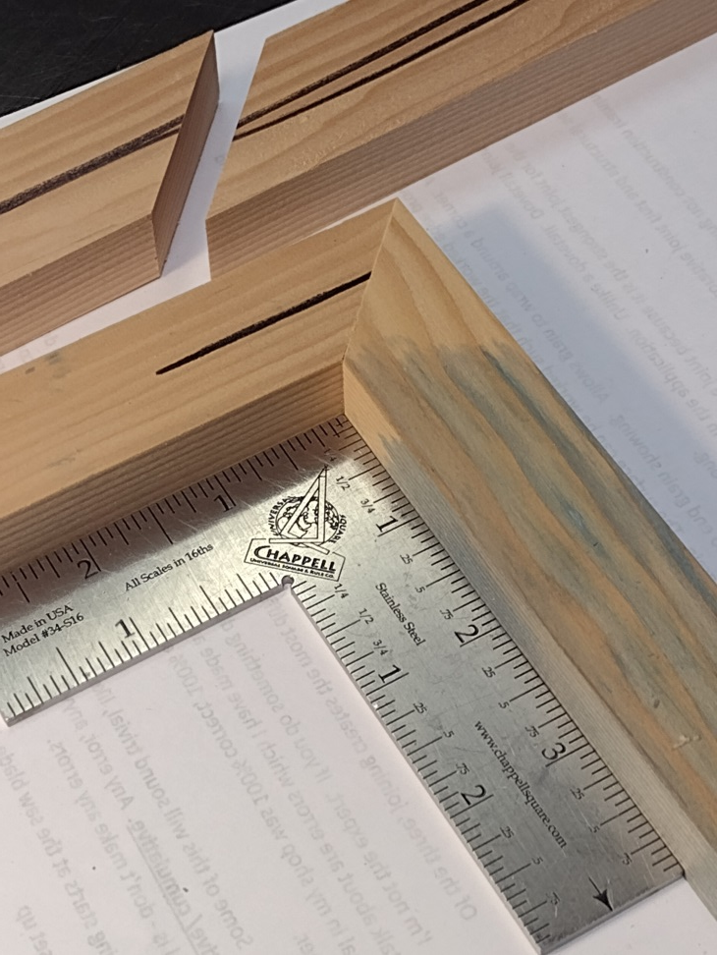
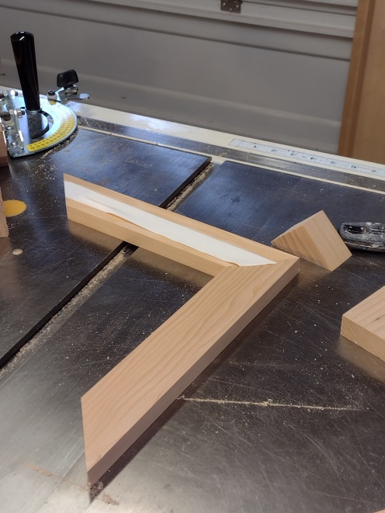
Is your blade sharp?
It is imperative that the legs be exactly the same length. When using flat stock, tape together and cut as a unit.
Don’t guess at your angle. Cut a sample. Check it for square.

Slide 11
When cutting tall mitres on flat stock, cut the mitre first then split the board. Both are matching lengths.
This is the best approach for really long pictures. This one is 11’.

Slide 12
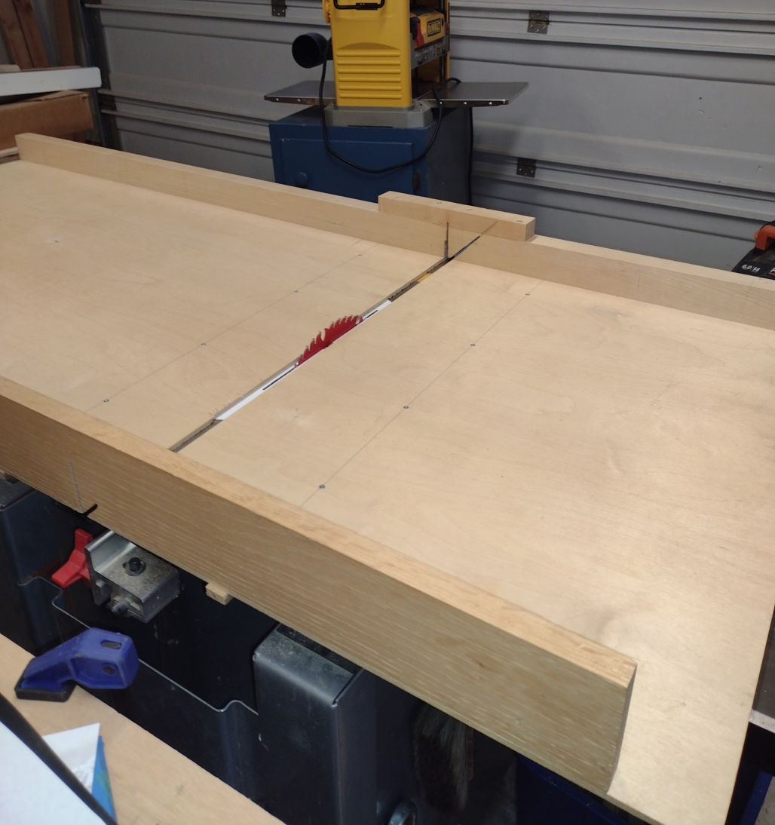
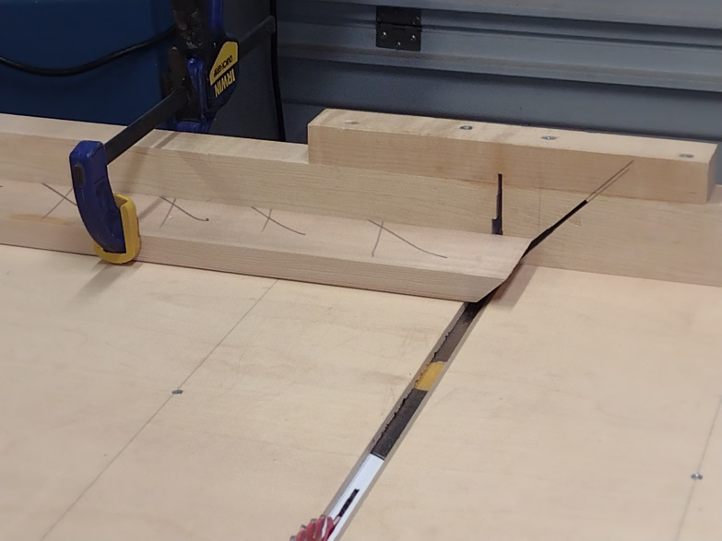
When in doubt – make a bigger cut off table
NO !

Slide 13
What are the Elements of a well made Joint?
Surfaces are well mated – smooth, even contact across entire surface of both pieces.
Glue thickness is correct and even across the joined surface - .004” or less.
Enough pressure is applied to the joint during curing to flatten any imperfections and squeeze out excess glue to reach an even glue line of .004” (thickness of a piece of office 20lb bond copy paper).
The glue has an appropriate time to cure under pressure before handling.

Slide 14
How to glue a mitre joint with end grain
Two steps:
1. Apply glue to both surfaces and allow to soak into the wood (clarify). This takes 5 – 10 minutes. This step fills up the vascular tubes and closes them.
2. Wipe off the excess glue, apply a second layer of glue and clamp immediately.

Slide 15
How does glue work?
Glue has two types of bonds – mechanical and chemical
The mechanical bond is the bond which forms when the glue surrounds the wood fibers and dries/cures. This physically holds the wood together.
The chemical bond is the molecular lattice which forms in the glue and attaches to the molecular structure of the wood. The chemical bond will act as if there is no distinction between the two pieces of wood and will form across the gap between them thus chemically tying the two pieces together . The chemical bond can only span a limited distance, .003 - .004 inches. Gaps wider than this distance will only be held by the mechanical bond. The strongest of the two bonds is the chemical bond.
It is the strength of the chemical bond which gives rise to the (accurate) comments that a glued joint is stronger than the wood.
Understanding Wood, Bruce Hoadley

Slide 16
How much clamping pressure is needed?
To achieve its maximum strength, the joint will need pressure of between 150 to 250 lbs/sq in (depending upon wood density) to squeeze the glue to an even thickness of 3-4 thousands of an inch and flatten any imperfections in the joint.
In addition, that pressure needs to be applied across the joint perpendicular to the direction of the joint and maintained throughout the drying/curing process.
Most C-clamps, F-clamps, bar clamps, wood screw clamps and pipe clamps can achieve 350 – 400 lbs/sq in or in excess to that.
Understanding Wood, Bruce Hoadley

Slide 17
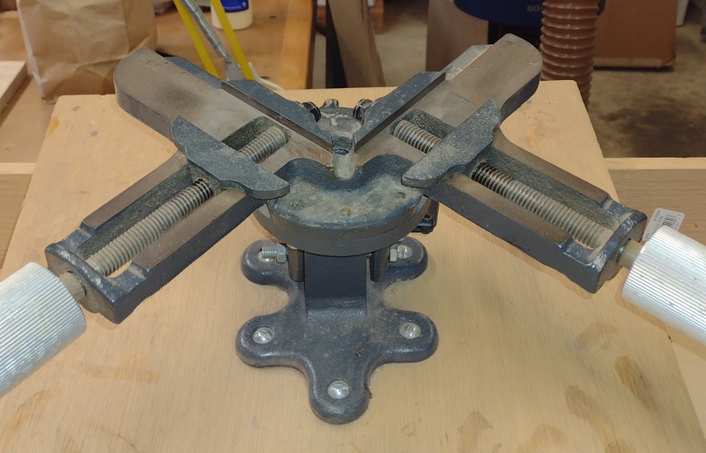
Types of clamping strategies for mitres
Strap clamps
Get Creative!
Glue Blocks
Framing Vice
Tape

Slide 18
Mechanical Fasteners in conjunction with glue and clamps.
Are they necessary?
Mostly, yes, depending upon the application.
Mitres made with side grain to side grain gluing should be as strong as any side grain gluing (e.g., tabletop glue up) as long as the joint is adequately prepared, glued and clamped.
Mitres, especially end grain to end grain applications, are mostly used for decorative purposes. Even with appropriate gluing and clamping, they are not as strong as most other types of joints
Types of fasteners:
Splines – most often seen
Nails – common in custom framing
V-Nails – the industry standard for custom picture framing

Slide 19
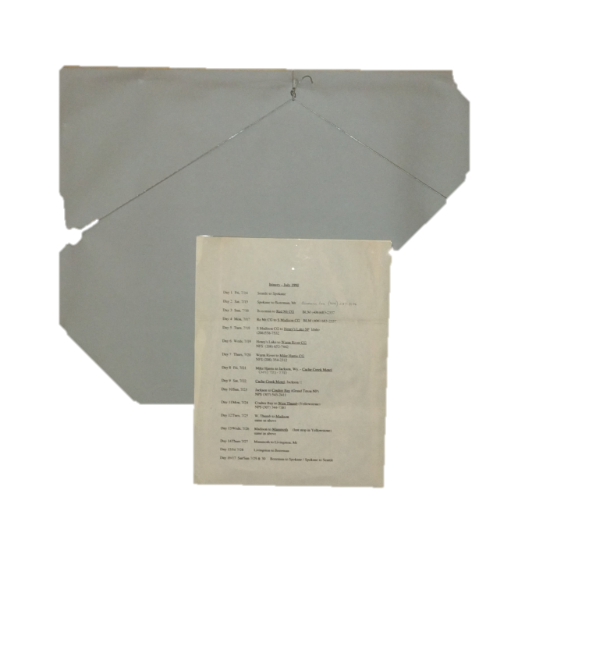
Picture Frames
A picture frame almost always needs support in the corners. The diagonal pull of the wire across the back of the picture exerts a twisting pull on the frame which can crack the corners if the corners are not supported.

