Slide 1
Making a Wood and Resin Table
Keys to Success

Slide 2
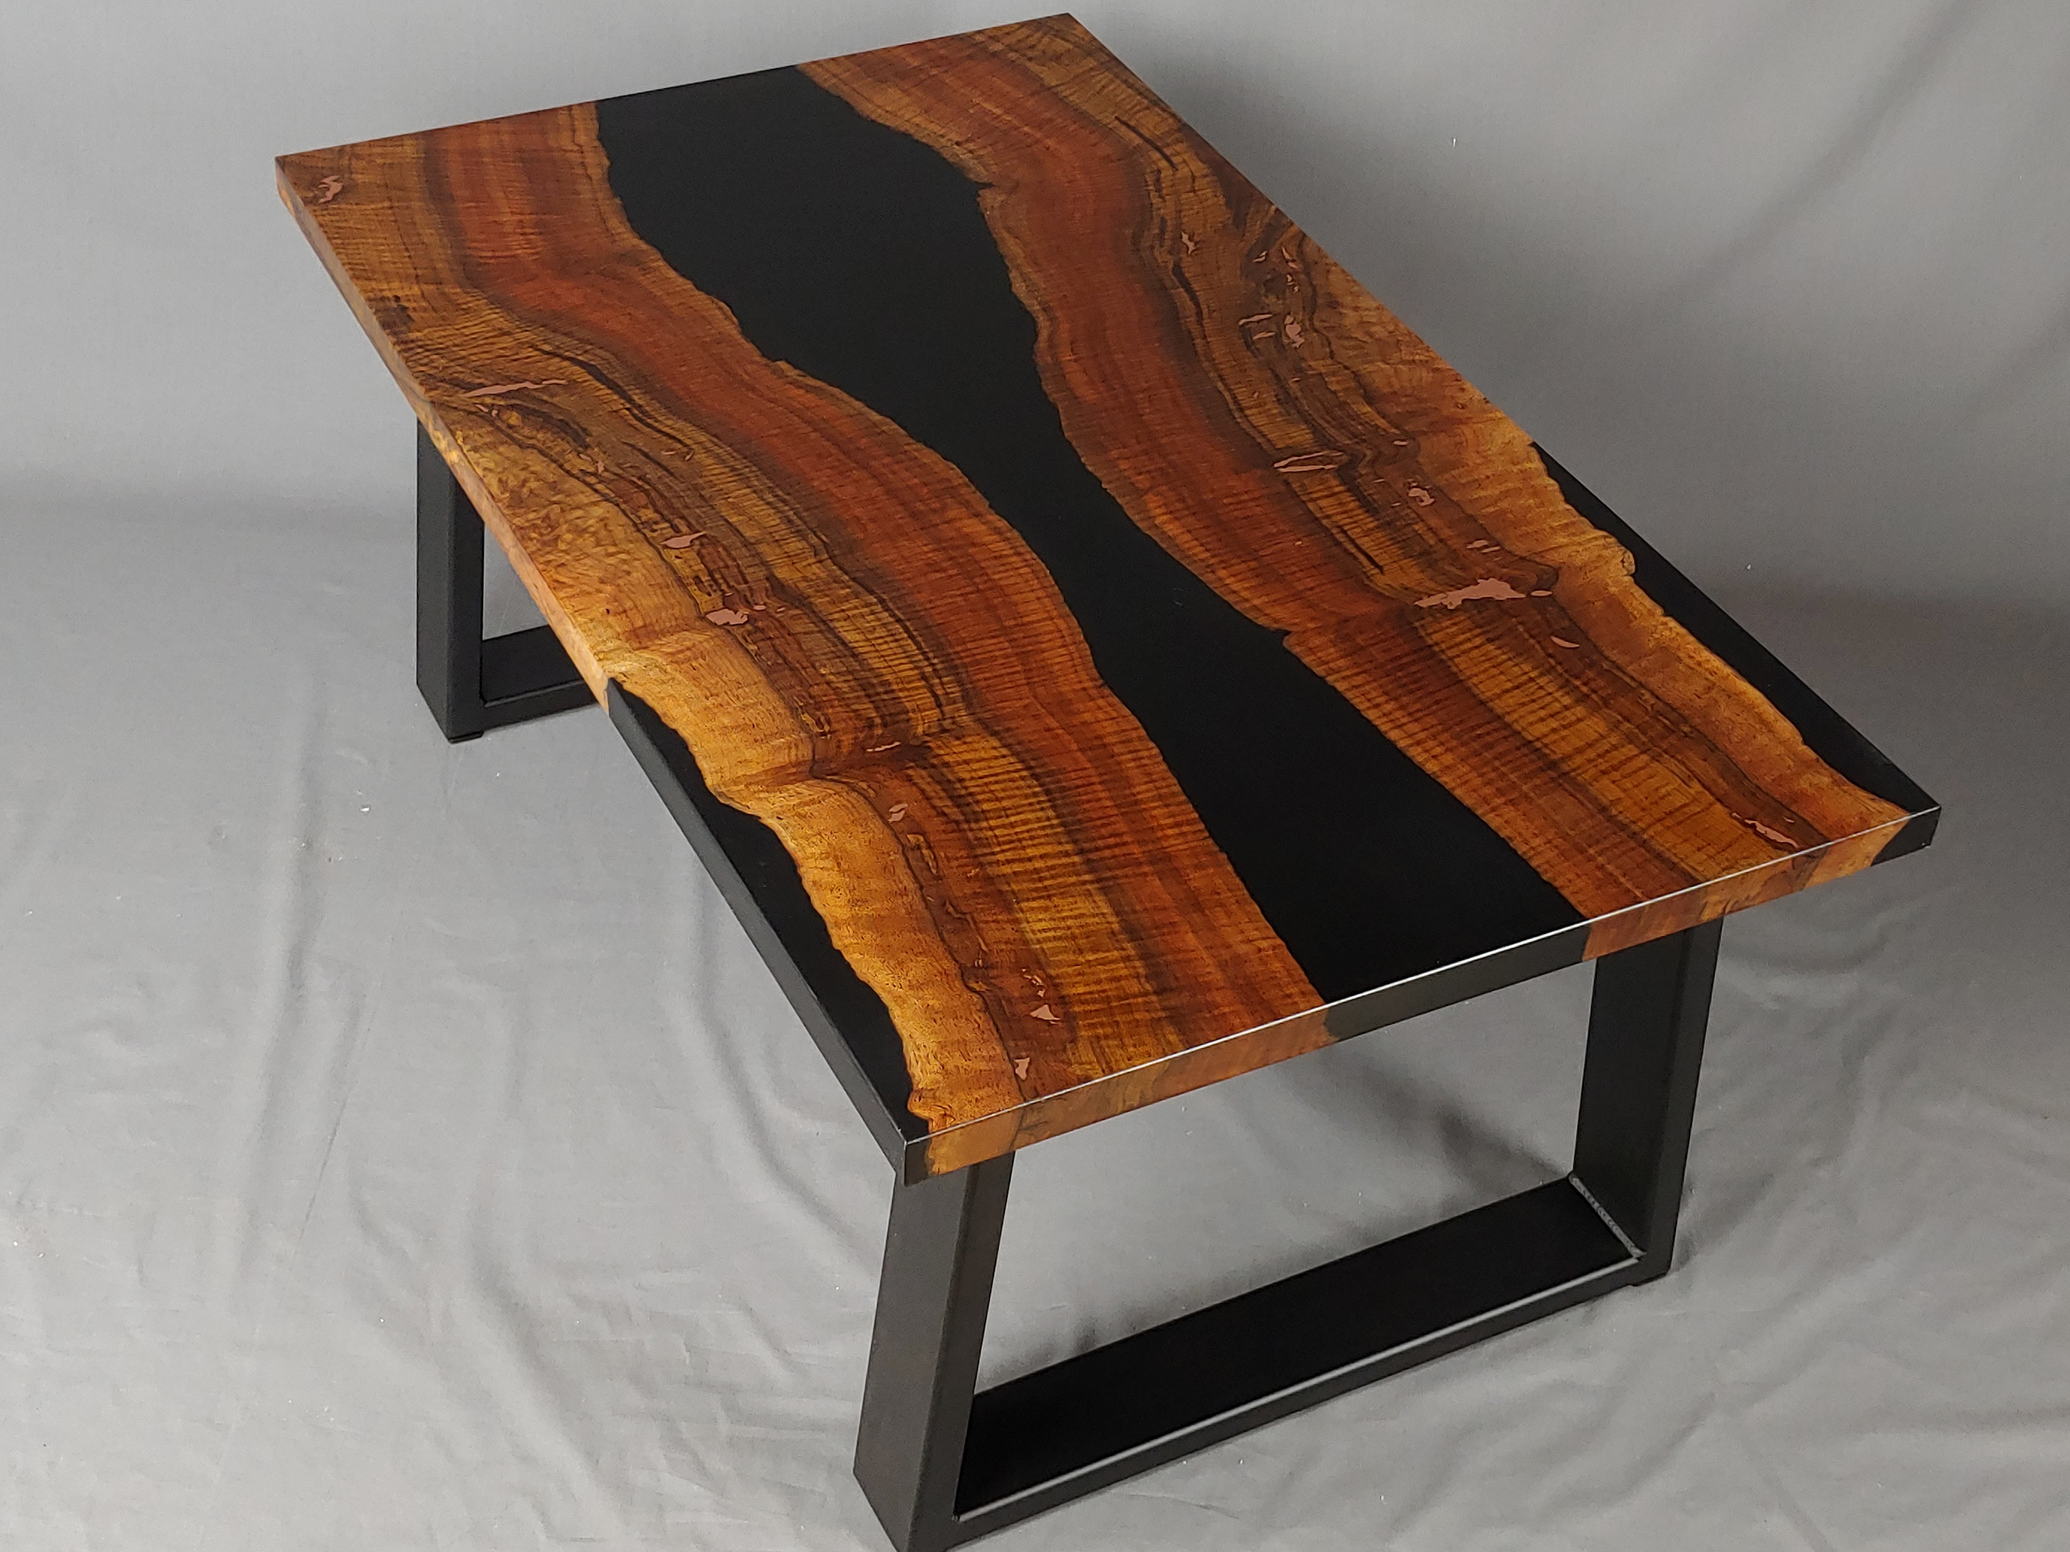

Slide 3
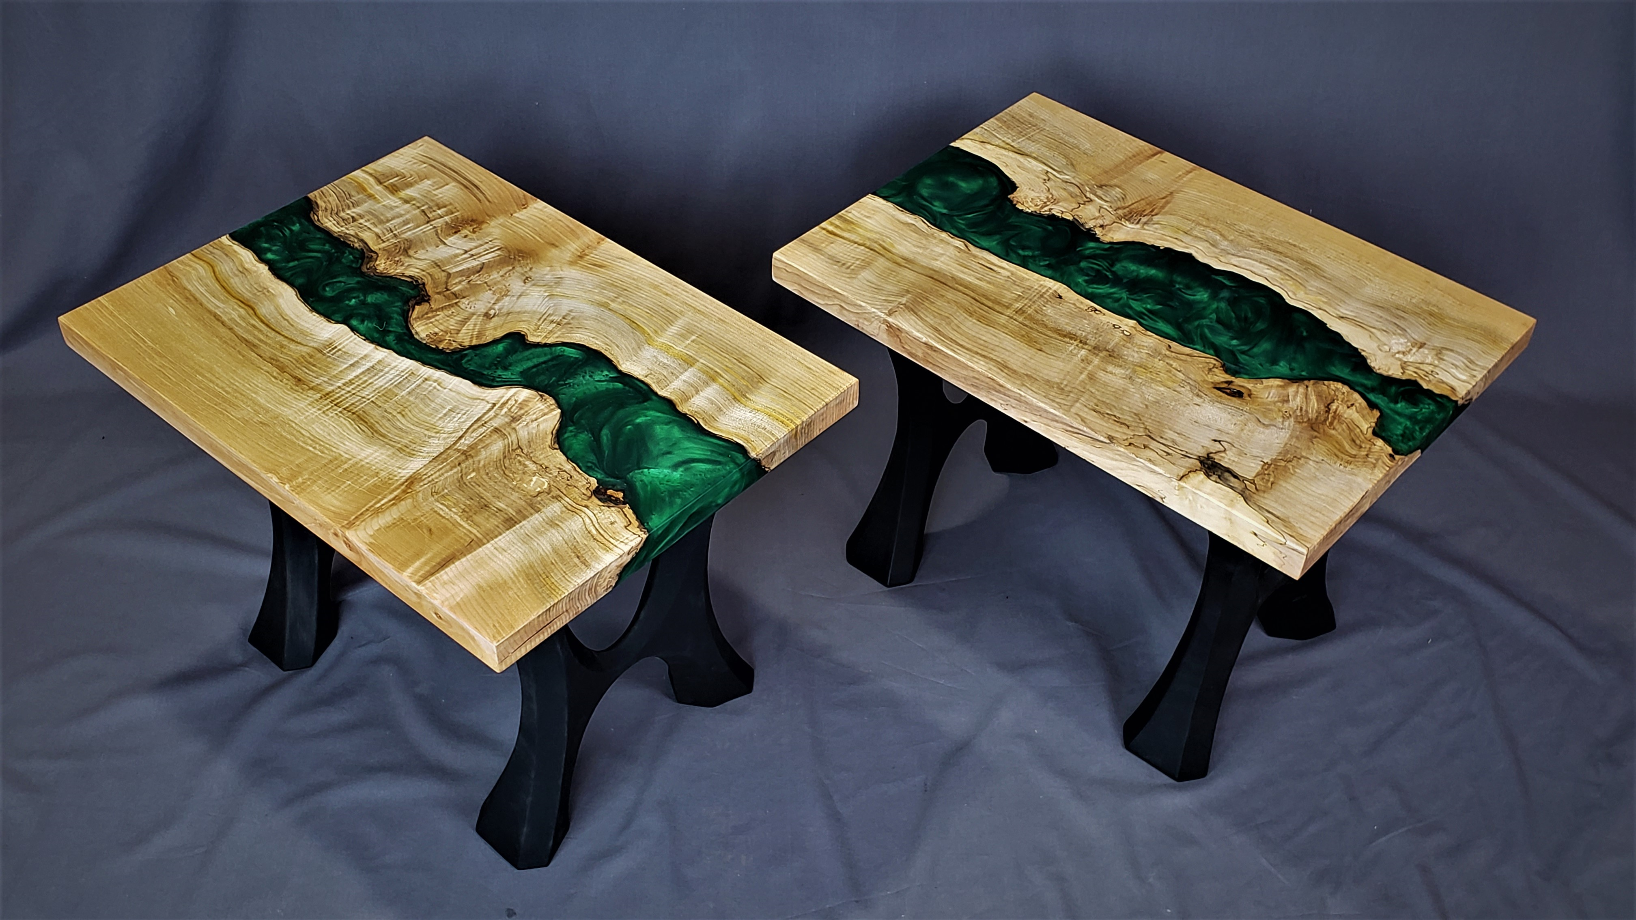

Slide 4
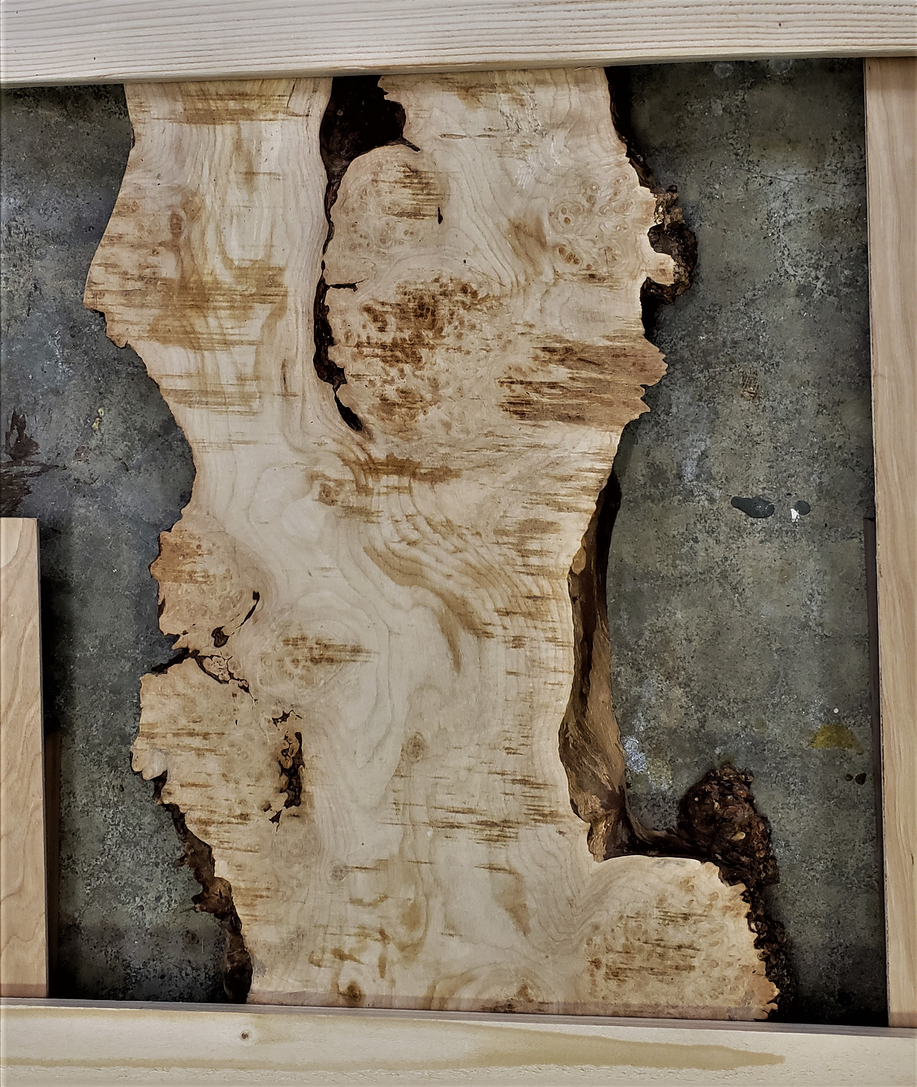

Slide 5
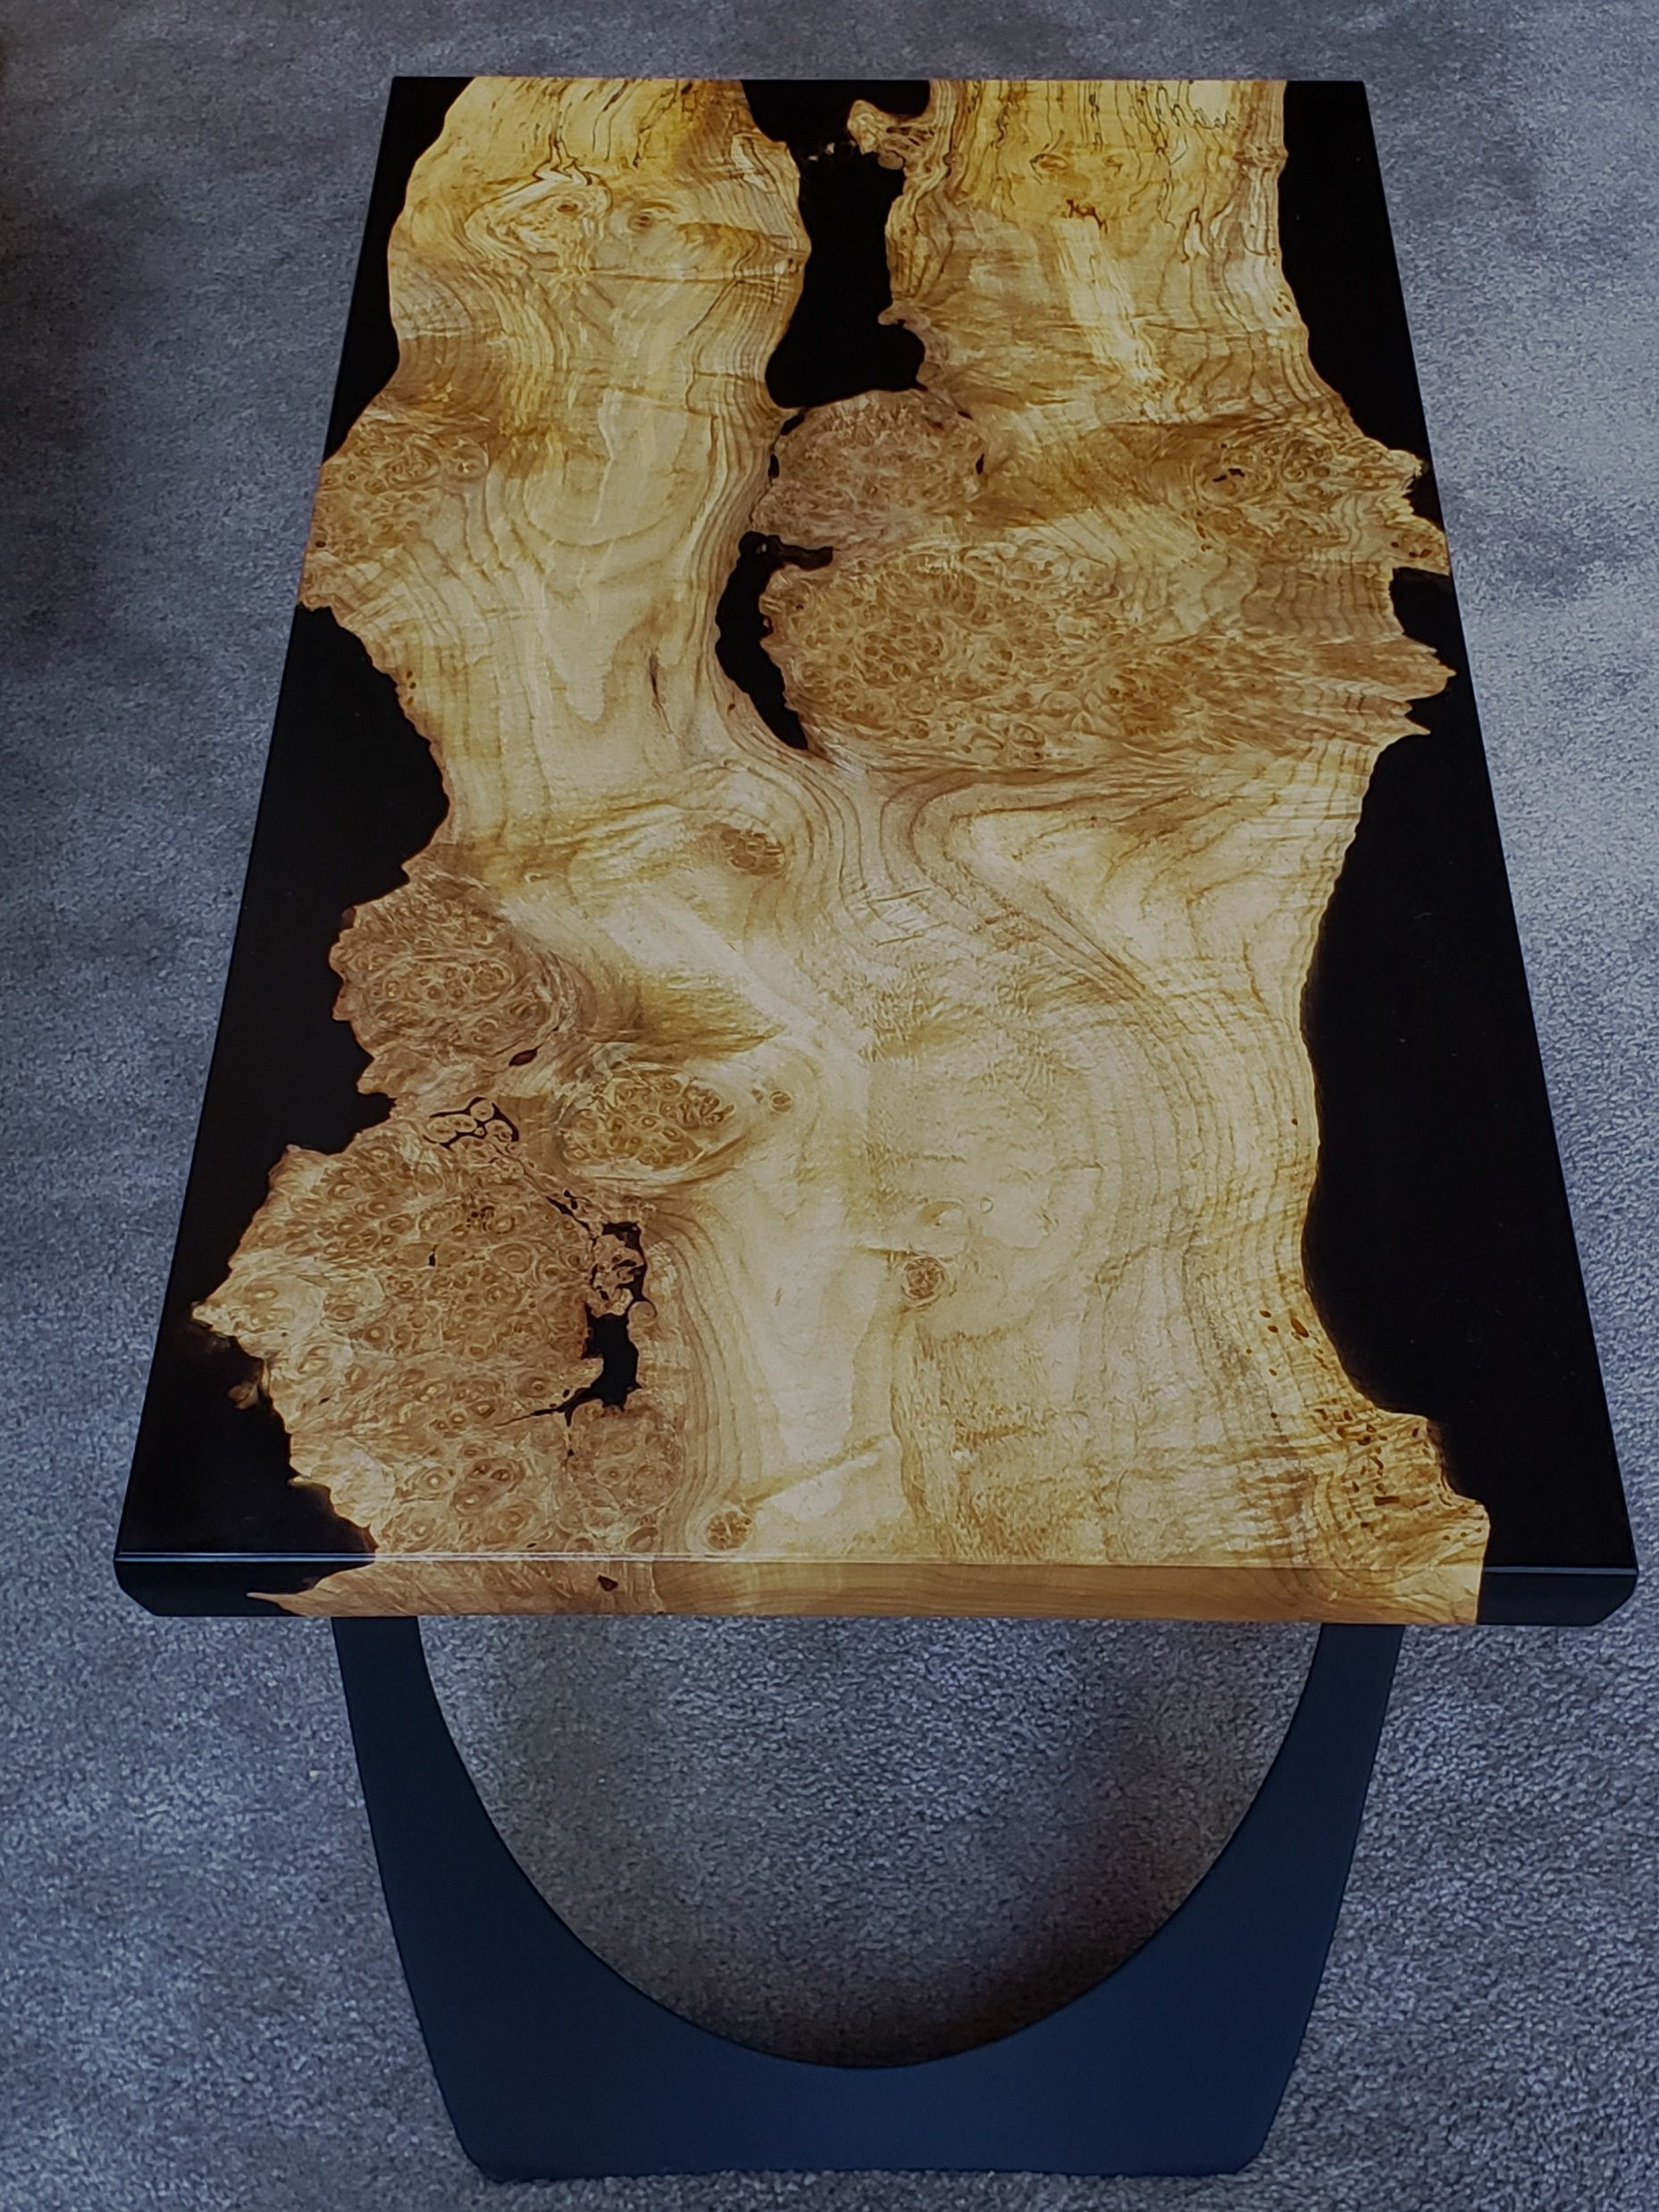

Slide 6
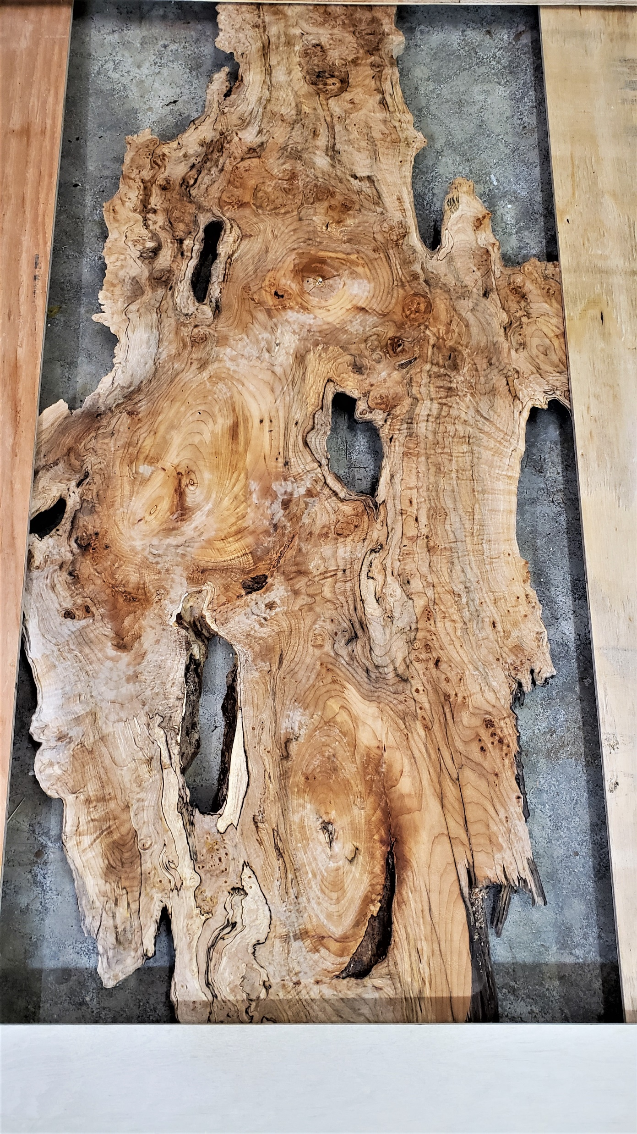

Slide 7
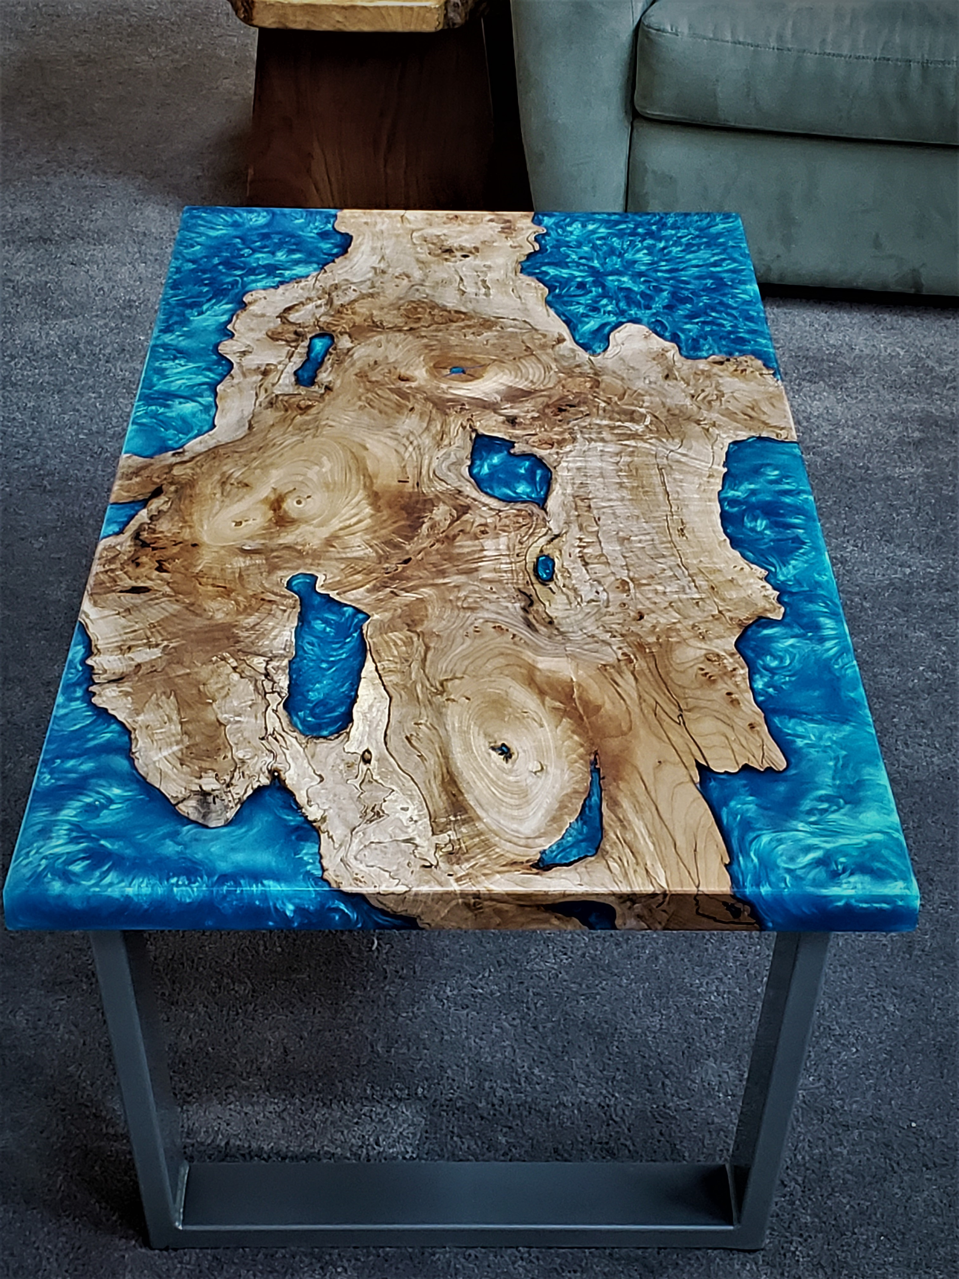

Slide 8
Downside of Resin
Messy
sticky when liquid
static charge to dust and shavings

Slide 9
Downside of Resin – Con’t
Expensive - $17/ quart = $42.50/ bdf
Can be Stressful
Mold leaks
Curing problems - overheating

Slide 10
Why use Resin?
Allows the use of beautiful wood that might not otherwise be usable
Fill cracks and voids
Show off natural edges

Slide 11
Resin
Superclear 2.0 Liquid Glass Deep Pour Epoxy

Slide 12
Safety
Generally considered non-hazardous
Possible skin and eye irritant
Use in a ventilated area
Avoid skin contact
Gloves and protective clothing
Dust mask when planing and sanding

Slide 13
Wood Selection and Layout
Choose wood you love
1 ½” minimum thickness
Create a frame – rigid or loose strips

Slide 14
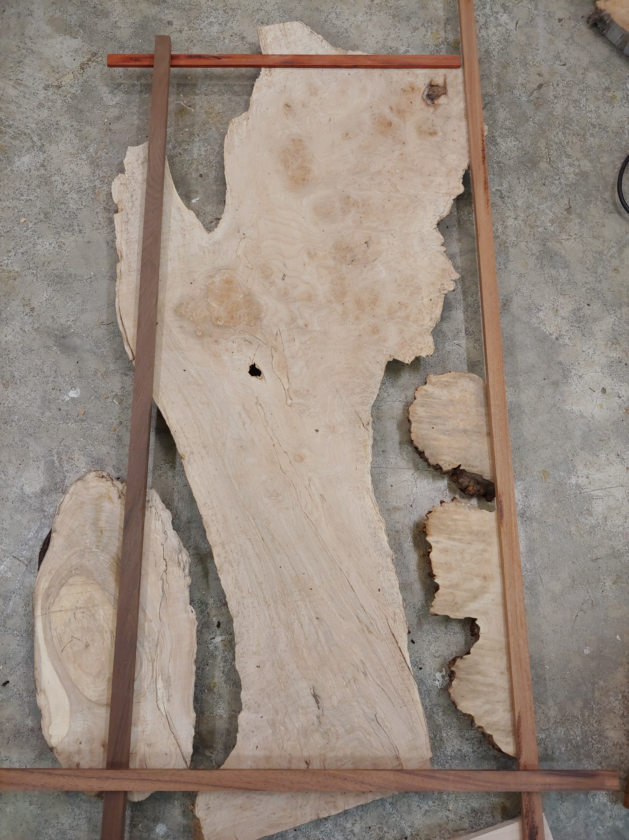

Slide 15
Wood Selection and Layout – Con’t.
1” oversize
Key – All edges next to epoxy must be natural
No Straight cuts
Cutting a curve likely won’t substitute for natural edge

Slide 16
Slab Preparation and Clean-up
Edges must be clean – No dirt, NO BARK
Tools
Screwdriver
Wire wheel – aggressive
Nylon wheel
Restorer
Dental picks
Dremel
Vacuum thoroughly

Slide 17
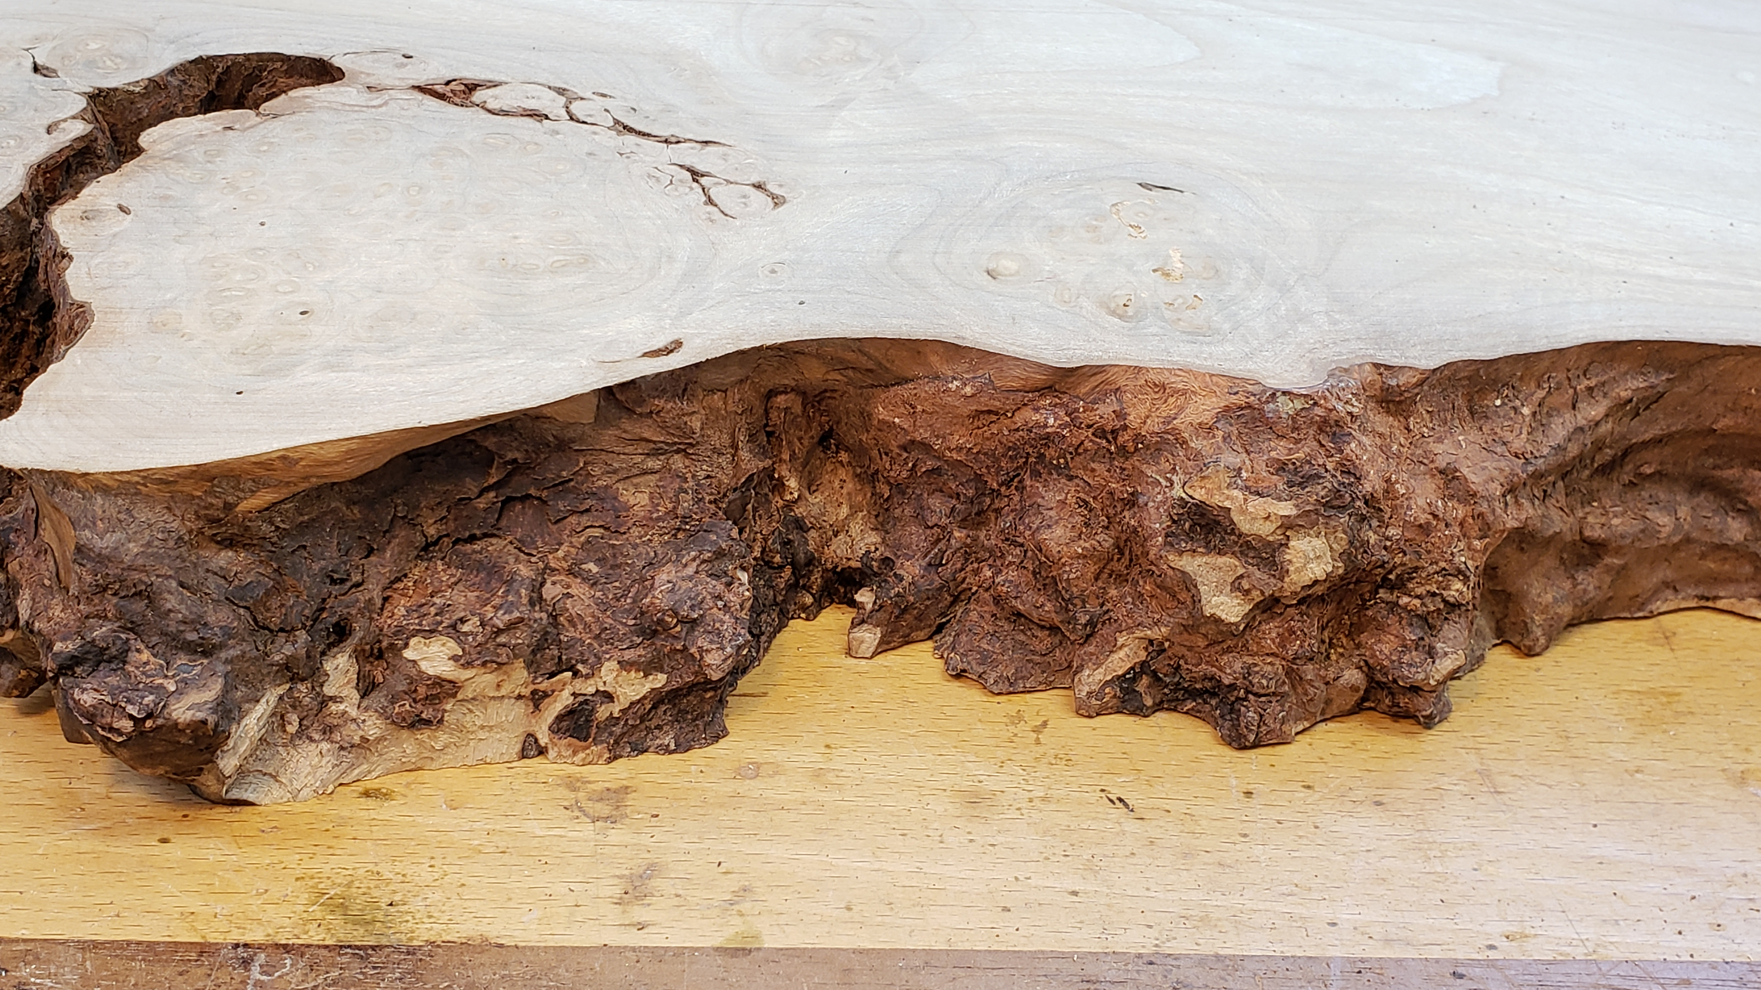

Slide 18
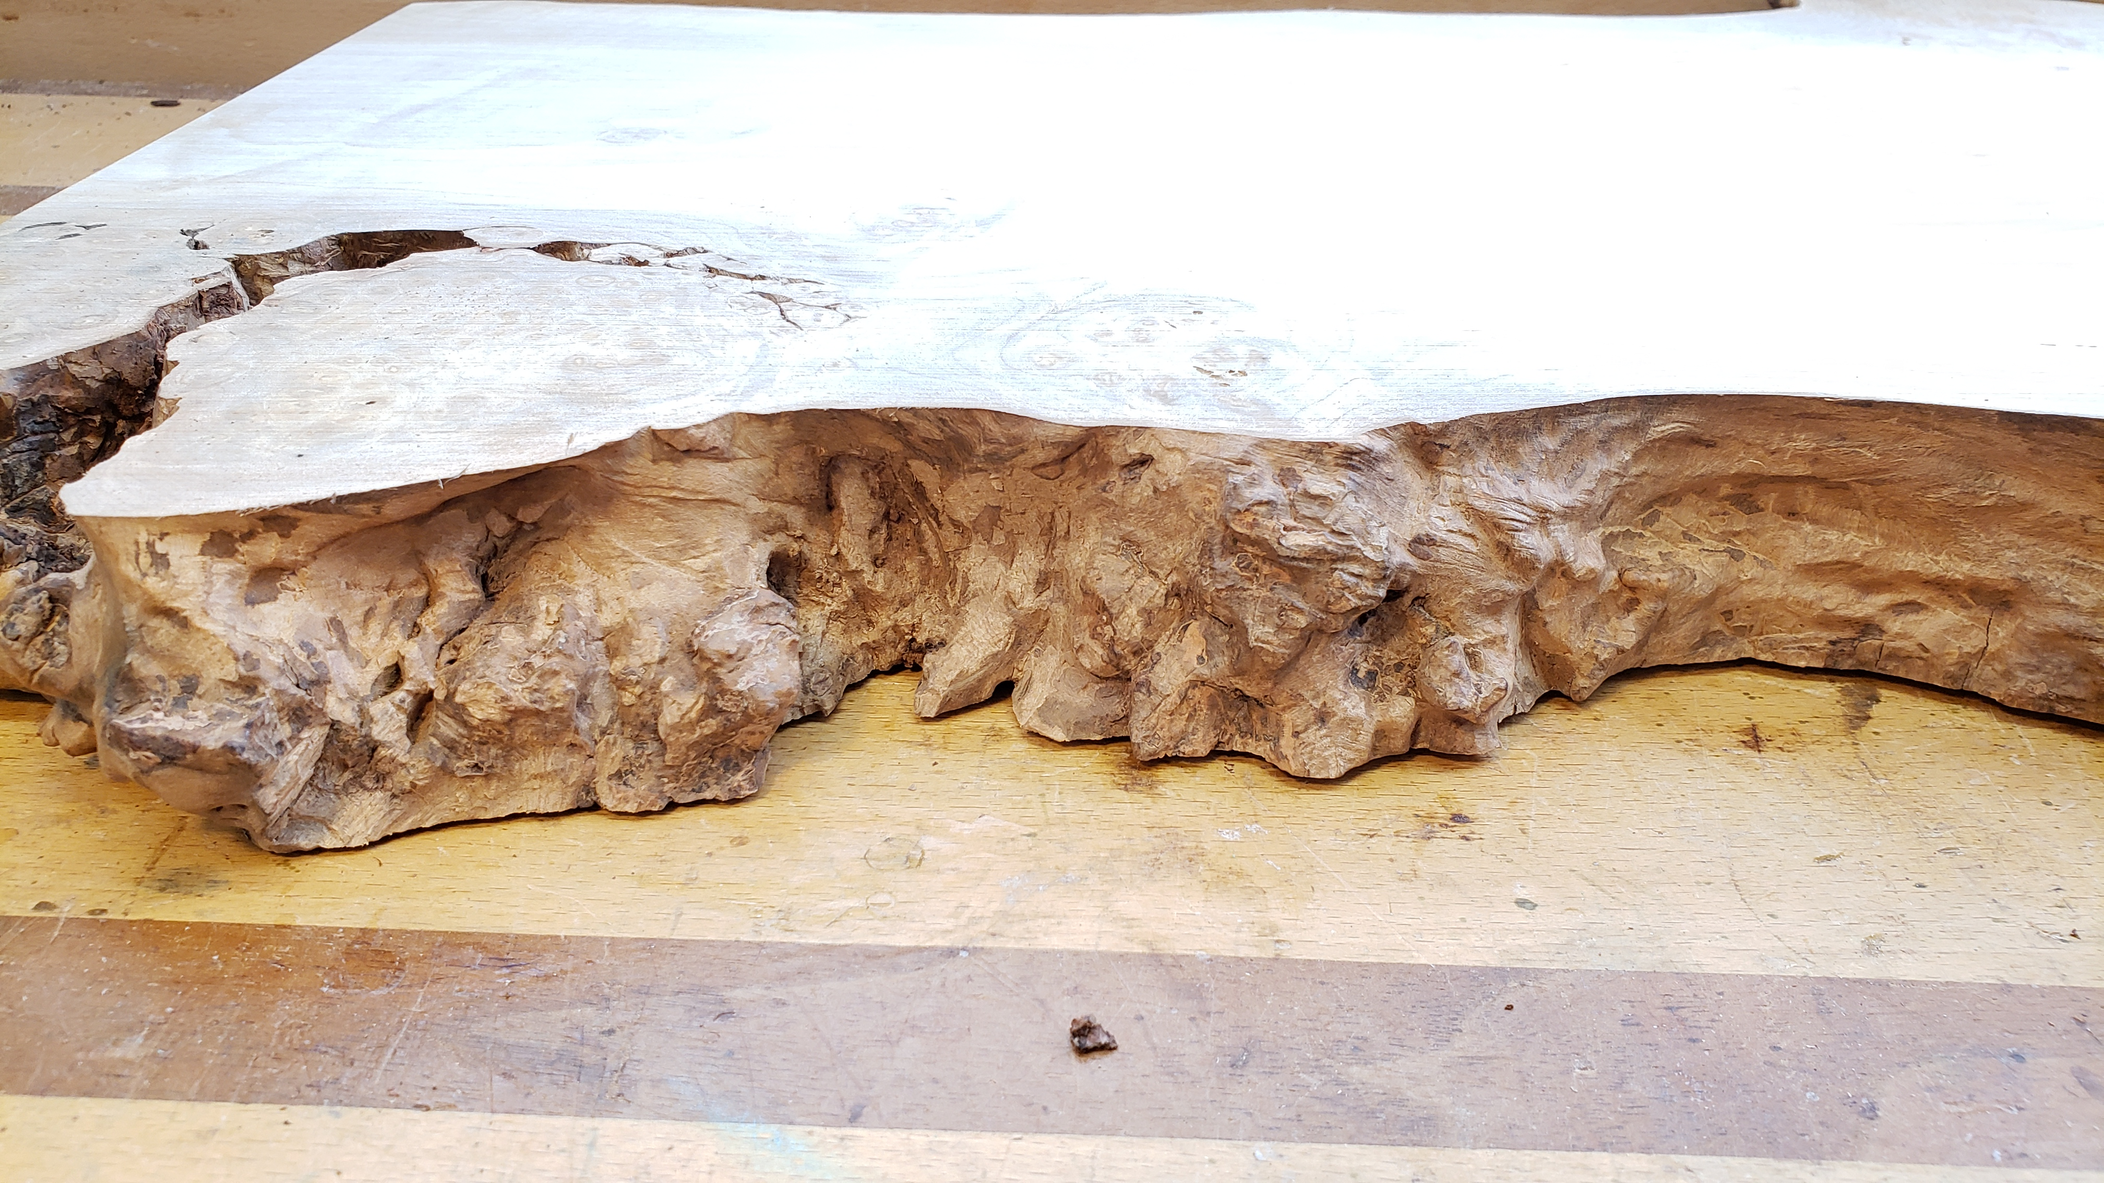

Slide 19
Building a Mold
Base – ¾” Melamine
Sides ( 3-4” high) on top of the base
Pocket hole screws to hold the sides in place
Caulk between the edge of the side piece and base
DAP Alex Fast Dry caulk

Slide 20
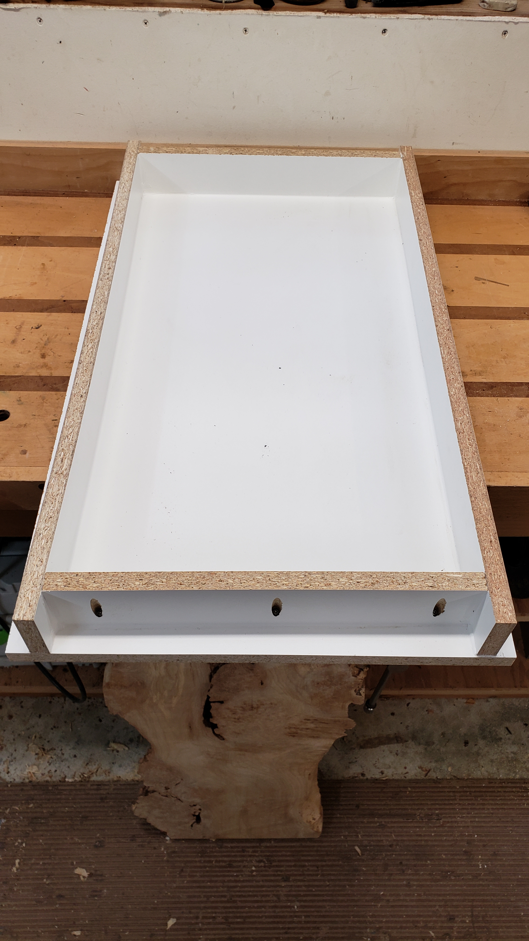

Slide 21
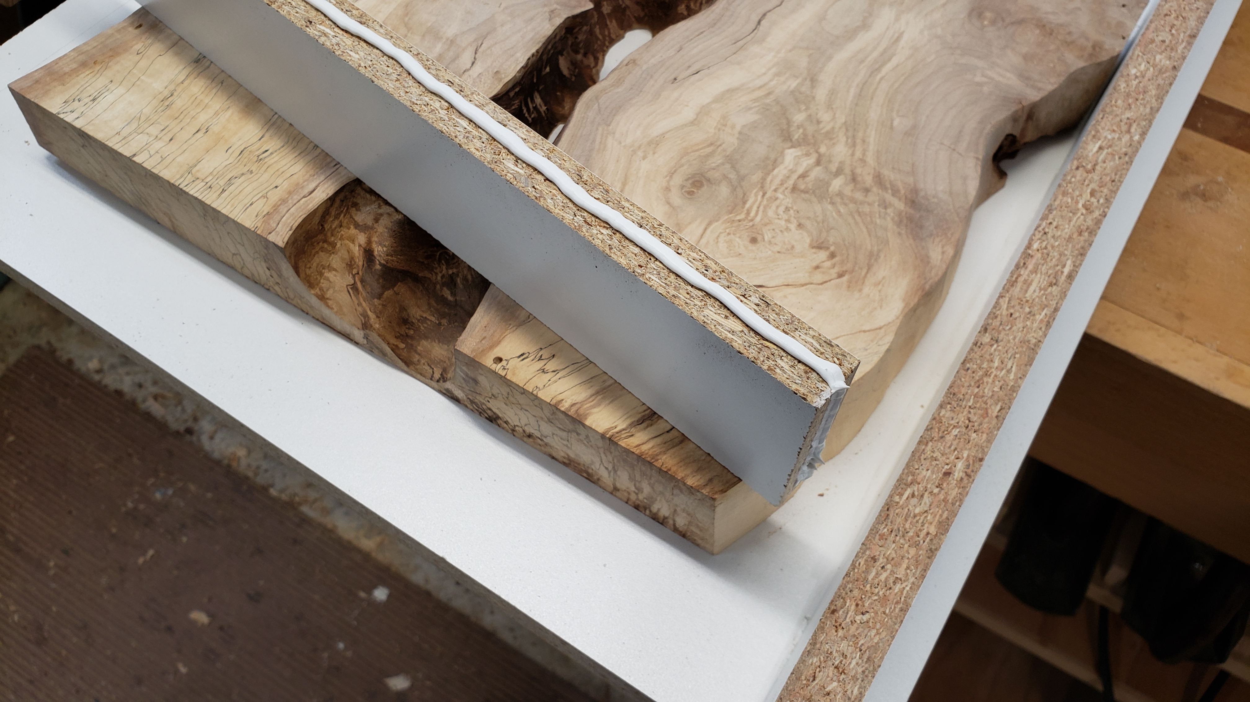

Slide 22
Building a Mold – Con’t.
Key – CAULK ALL CORNERS – allow 24 hr cure
Key – USE MOLD RELEASE – don’t spray indoors
Smooth-On Universal Mold release

Slide 23
Seal your slab
Sealing prevents staining – especially when using liquid dye
Sealing prevents bubbles – air released from wood
Use Deep Pour Epoxy - Paint top, bottom, sides and ends
Sealing the Top helps prevent warping during curing – stops moisture transfer
Put slab in mold to begin curing
Let set until tacky: 12 – 18 hours – still creates chemical bond

Slide 24
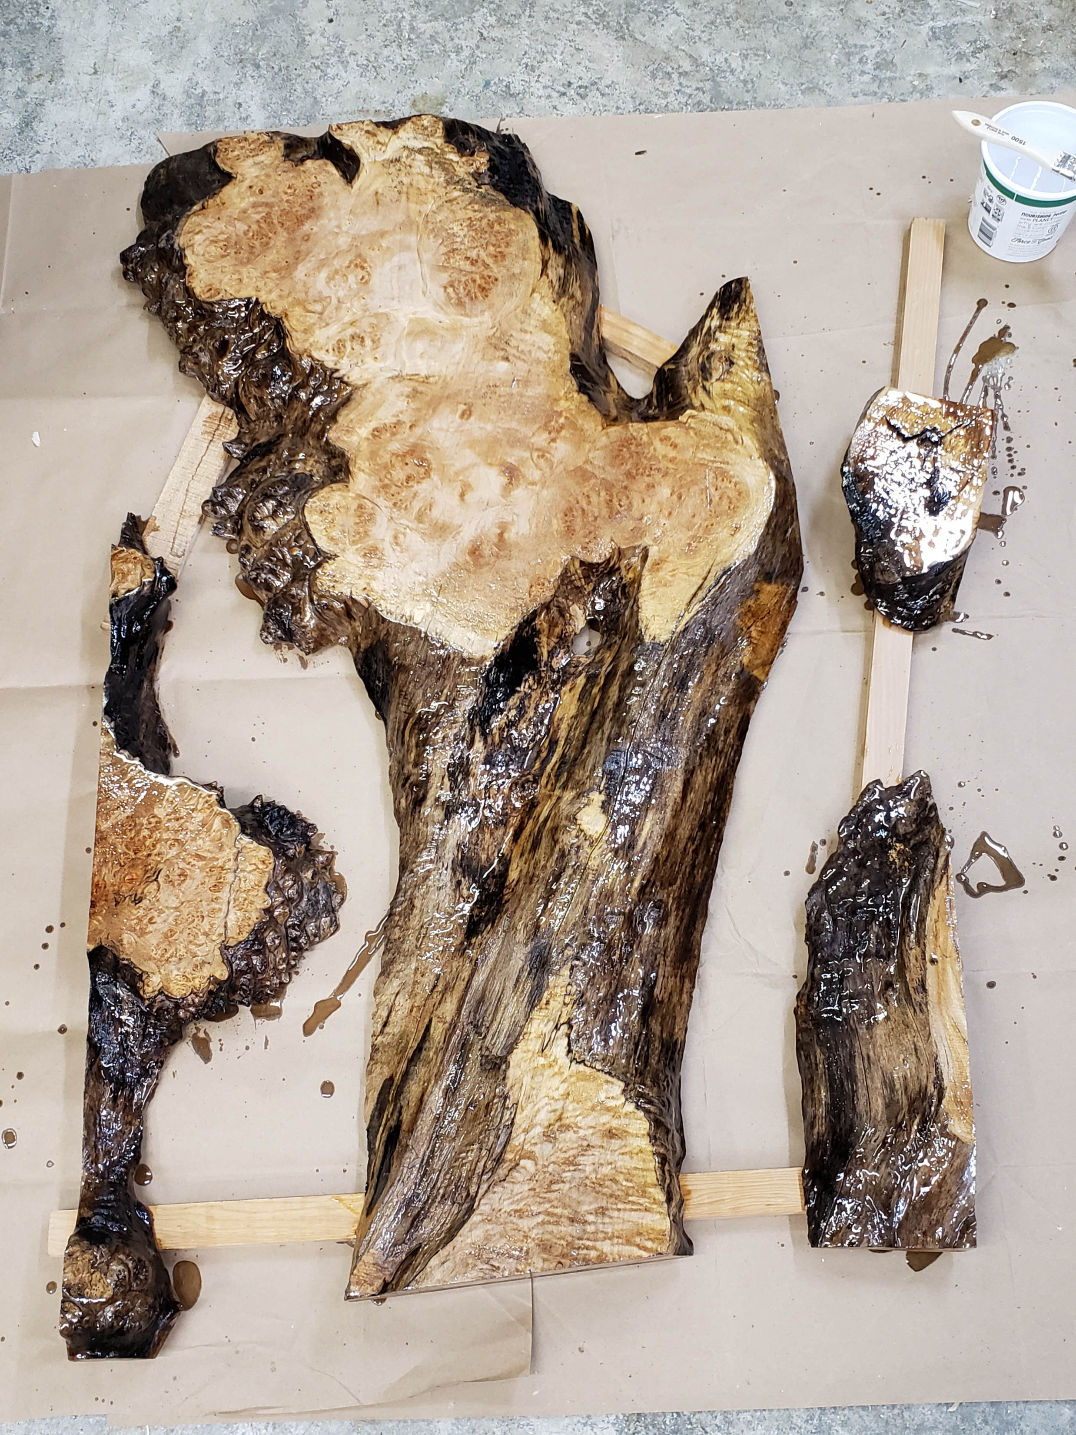

Slide 25
Seal your slab - Con’t.
Spalted or other soft wood
Table Top epoxy – 2 to 3 coats may be needed to seal
Cure until hard – 24 hours
Sand thoroughly – creates mechanical bond
Clean surface with isopropyl alcohol

Slide 26
Set up your mold
Elevate your mold - need airspace beneath it
Clamp your wood in place – wood floats in resin
Level your mold – door shims work well

Slide 27
Mixing resin
Measure carefully – 2:1
Flat bottom bucket – 5 gallon
Key - Poor mixing = Failure - no way to recover
Cannot overmix Deep Pour epoxy
Mixing time – minimum 5 mins. I mix for 10 minutes
Low speed paddle mixer – drill works great
Scrape the sides and bottom - rotate the bucket

Slide 28
Add color to resin
Liquid dyes and powdered pigments
Liquid – solid color
Pigment – swirls
Check density of color – clear cup
Account for fastening hardware
Mixed resin should sit for 20 minutes – allows air bubbles to release
Use a torch or heat gun to remove surface bubbles

Slide 29
Pouring resin and monitoring your pour
Pour in the morning - all day to monitor
Ambient temp – 60 - 75 degrees
Brush the edges – releases air bubbles
Leak Repair – Rec. Flex Paste
Key – Always set a fan to ripple the liquid epoxy surface
Removes heat from the pour to prevent overheating
Check pour depth - Add resin as needed
Check for bubbles – torch as needed
Pigment settles -Stir at 12 – 24 hours

Slide 30
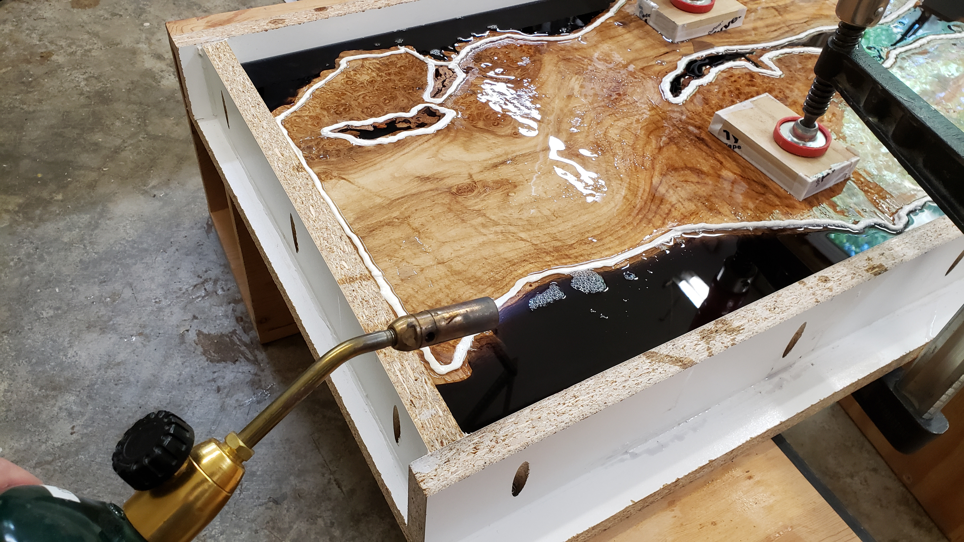

Slide 31
Remove the table from the mold
Cure time – initially 5 days
Full cure – minimum 2 weeks; 3 weeks better
Mallet to knock off the sides from the form
Wear gloves – resin edges are sharp
Stiff blade putty knife to separate a corner from the mold
Stiff plastic shims follow the knife

Slide 32
Flatten and square the table top
Commercial
Planer/Drum sander combo
CNC
Drum sander for small table – can be slow
Router sled
Can be shop built
Can accommodate almost any size top
Very messy; slow
Trim sides and ends
Track saw
Plywood strip clamped in place and circular saw

Slide 33
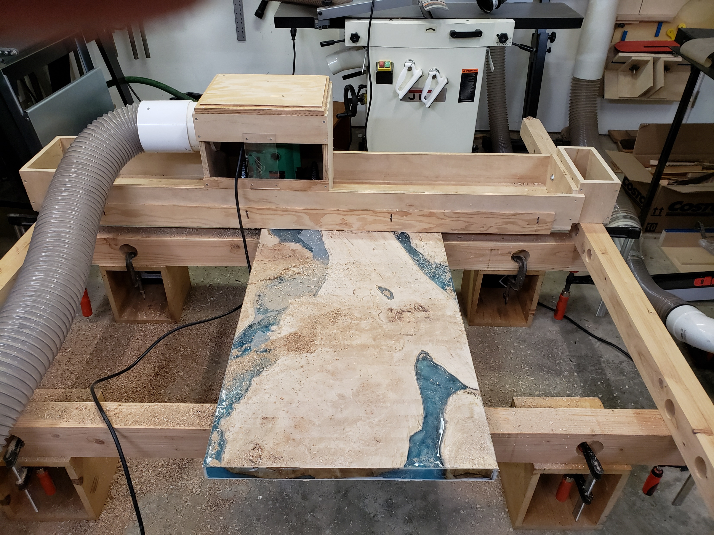

Slide 34
Touch-ups
Top will have small chips in resin & possible voids in wood
Table Top epoxy to fill larger chips and voids
Clear works well even with dyed or pigmented resin
Cures in 24 hours
Very small remaining chips
Fill with CA glue followed by activator; cures hard instantly

Slide 35
Sanding
Key – Evenly sand the entire surface. Don’t focus on problem areas
Draw a pencil grid across the entire surface to track sanding
Goal: Even scratch pattern after each grit
Preferred Sand paper - Cubitron 3M Extract
Very durable and resists clogging
Use a progression of grits
120, 150, 180, 220
Go to 320 and 400 on resin
Use micro fiber cloth to wipe every few seconds as you sand
Helps prevent clogging

Slide 36
Questions

