Slide 1
Drawboring Mortise & Tenon Joints

Slide 2
What is a drawbore joint?
Putting a peg through an offset hole to draw a joint together without the need for clamps.
“Simply put, drawboring is an intentional misalignment of the holes bored in the mortises and tenons. These holes are bored through each component separately, and they are offset so that a tapered pin driven into them will pull the tenoned rail up tight against the mortised stile.”
-Jennie Alexander
Make a Joint Stool from a Tree,

Slide 3
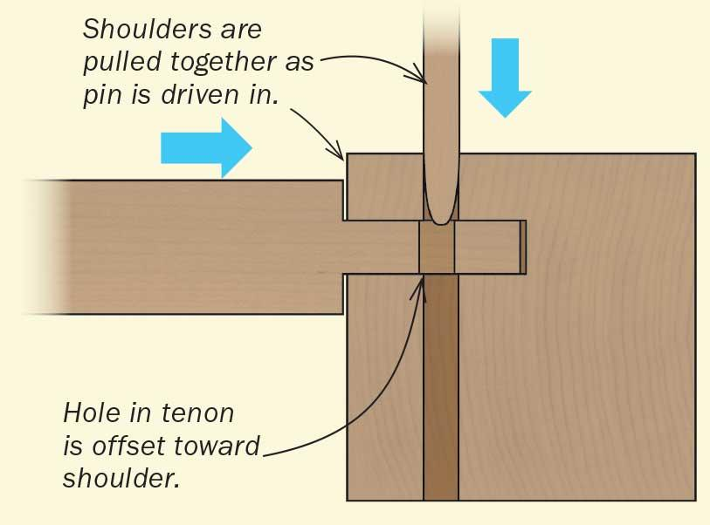
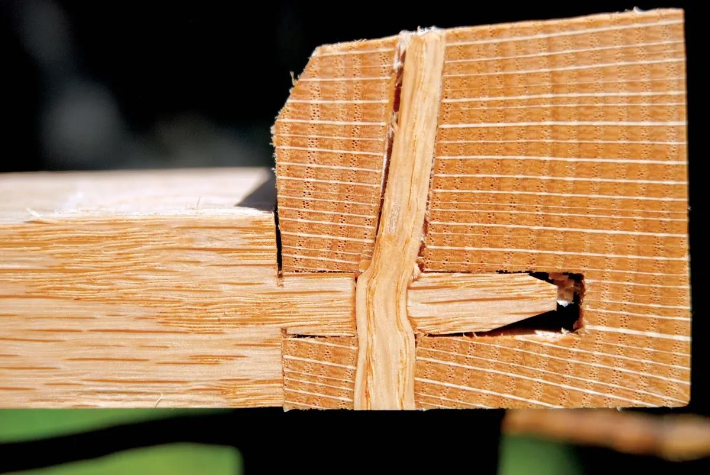

Slide 4
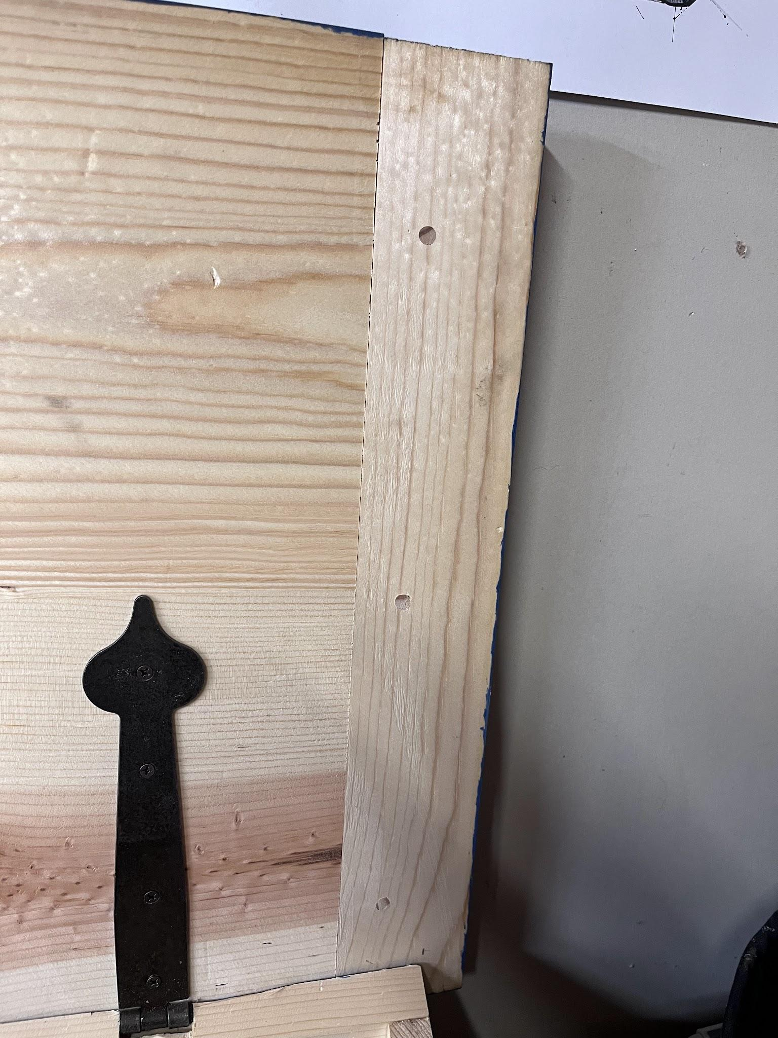
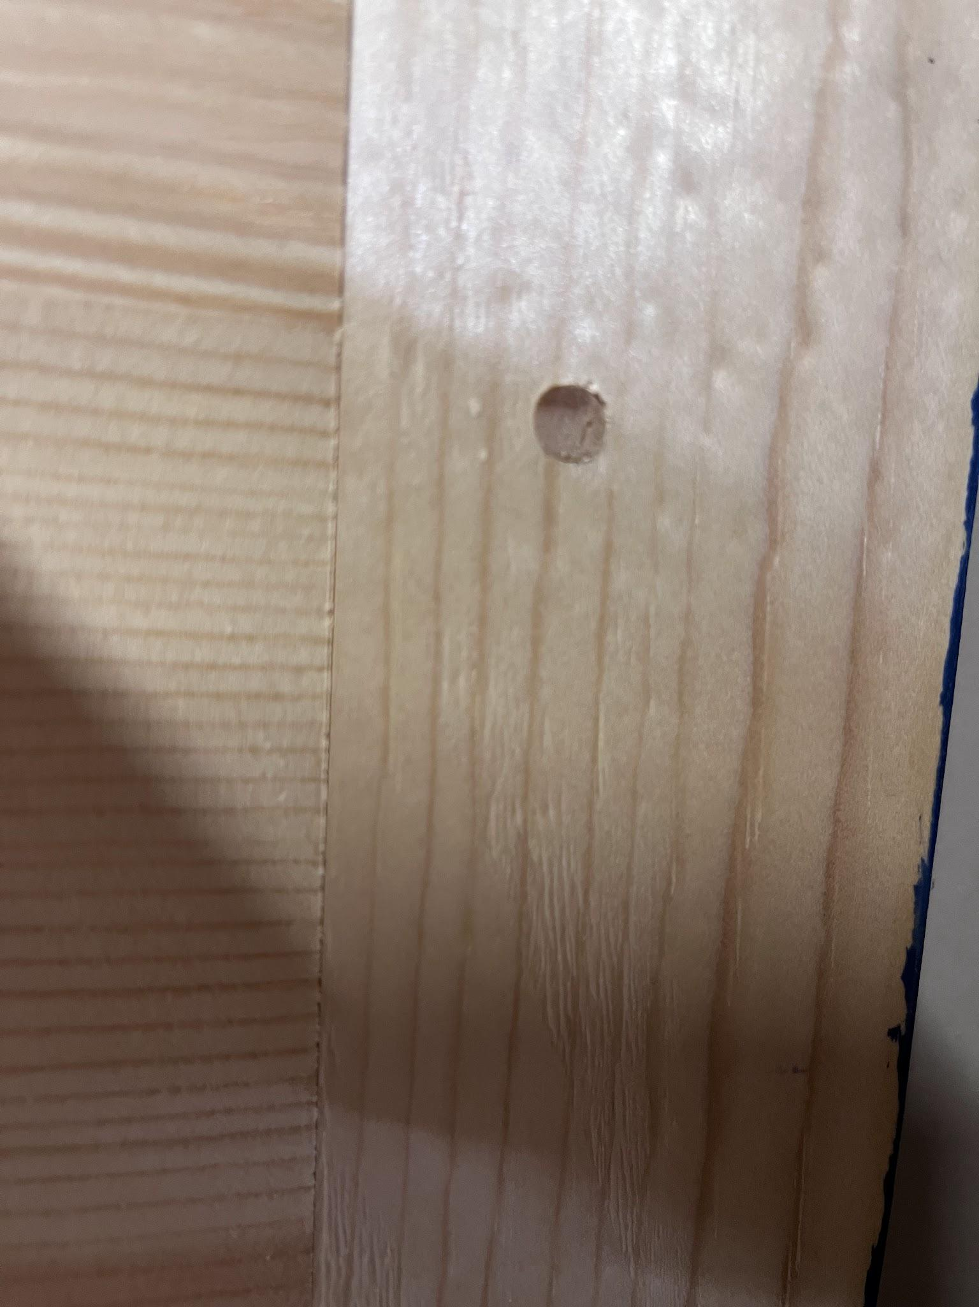
When to use drawbore joinery.
Any size mortise & tenon
Breadboard ends
Half Lap or Bridal Joints
Best used is situations that are difficult to clamp or when extra strength is needed such as tables or workbenches.

Slide 5
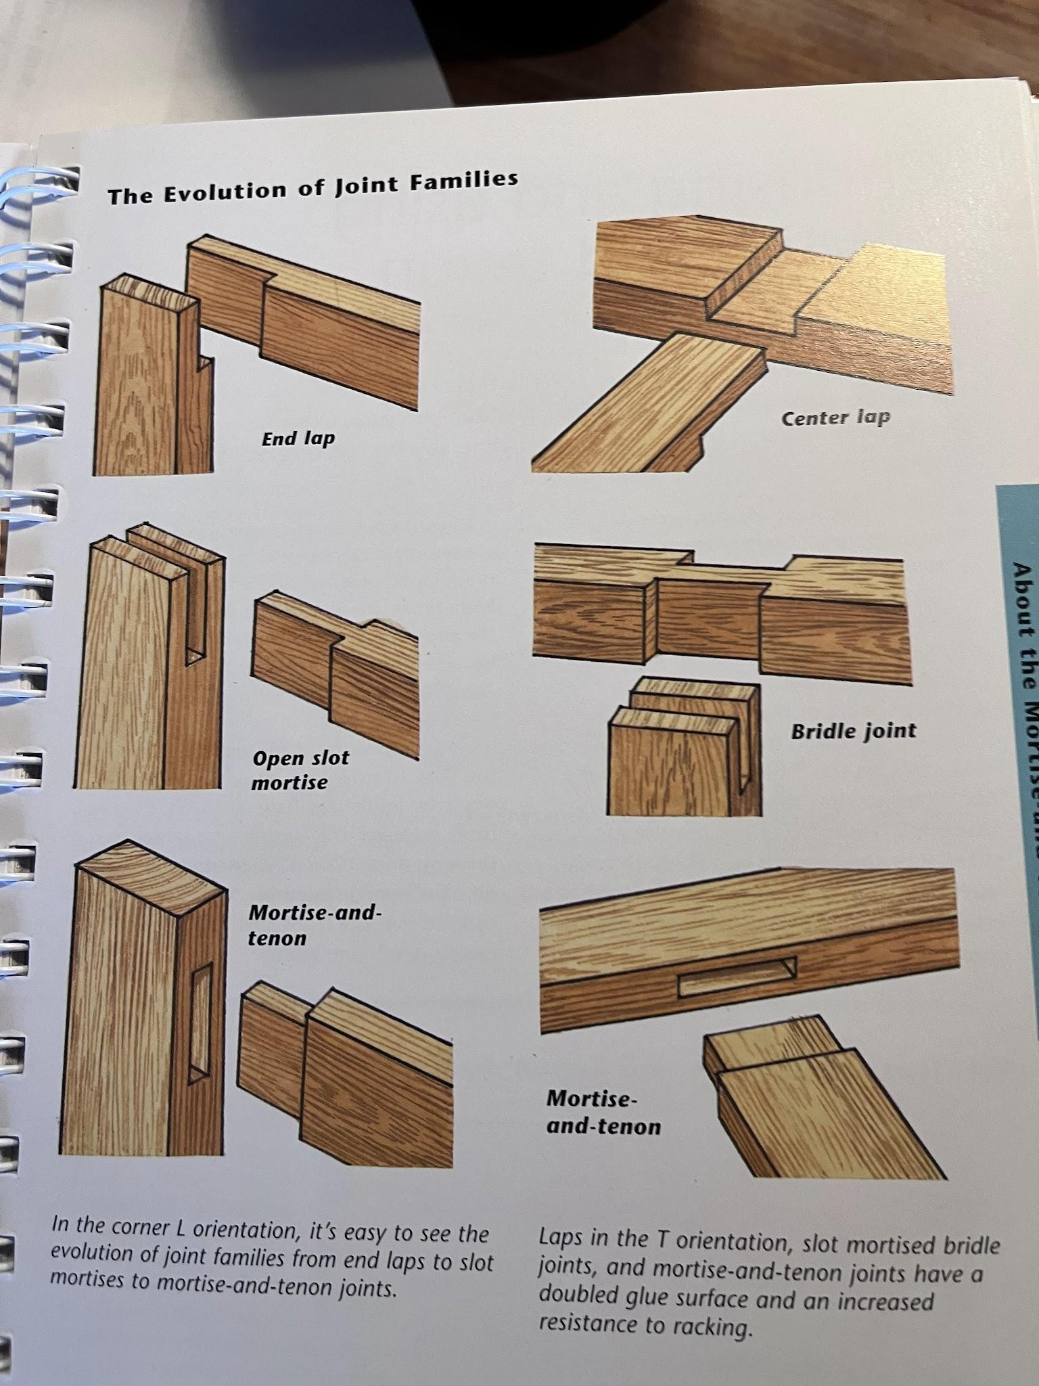
Any of these joints are perfect for drawboring.

Slide 6
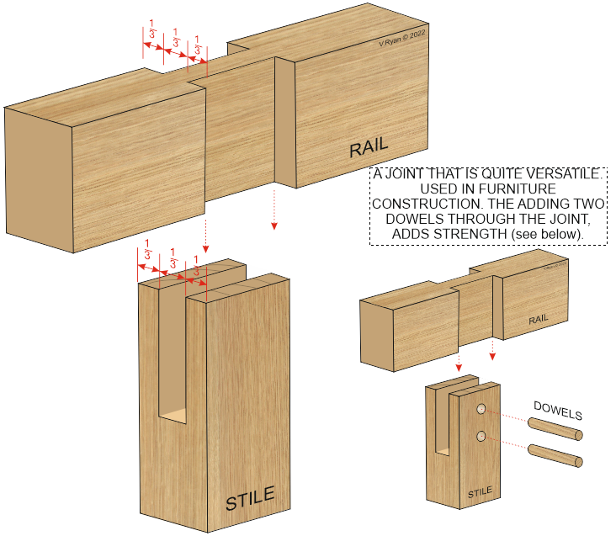
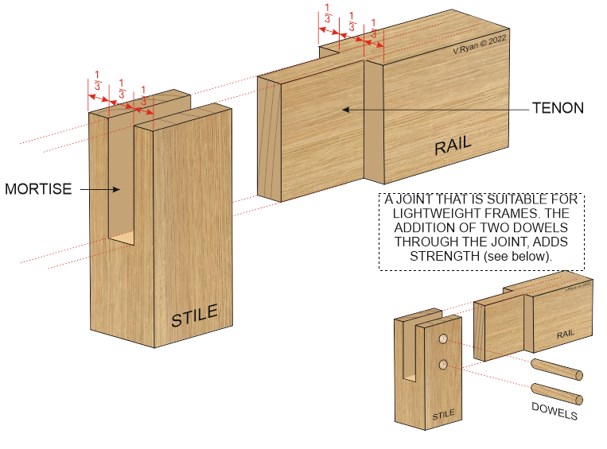

Slide 7
Advantages
Disadvantages
No clamps needed
Pin can be strong enough to continue work without waiting for glue to dry
Pin may not fit aesthetics of piece. Contrasting woods or making a blind pinhole can help.
Can be more difficult in thinner woods(<¾”)

Slide 8
How to set up a drawbore
Fit Mortise & Tenon
Drill hole through mortise
Select hole size based on size of lumber, strength needed and aesthetics
Holes may go all the way through the joint or be blind as in connecting workbench legs to solid top(Roubo or Anarchist Bench)
Place tenon in mortise and use drill bit to mark location
Remove tenon and mark with awl or drill bit location of hole in tenon
Mark will be 1/32” or more closer to shoulder
Bridal joints, lap joints may need extra care to determine where shoulder is
Cut pins 3” or 4” longer than needed
Sharpen point with chisel, belt sander, axe, etc..

Slide 9
How to set up a drawbore
Glue tenon and place in mortise
Pound pin through
Once glue is try trim pin flush

Slide 10
Pin Selection
Any wood is “fine”
Long grain woods like oak or ash considered “best”
Straight grain is critical
Otherwise pin may break
Make your own:
Lathe
Rive/Split (straightest grain option)
Buy from lumber yard/big box

Slide 11
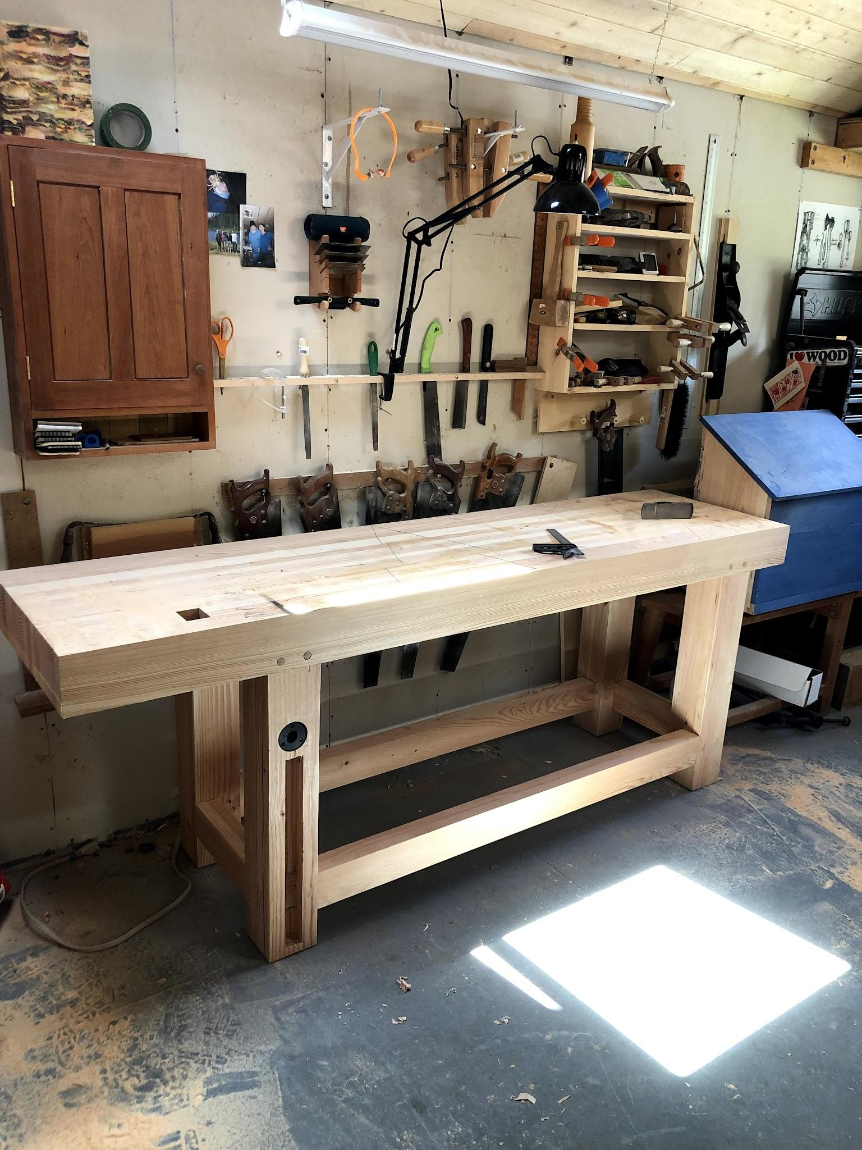

Slide 12
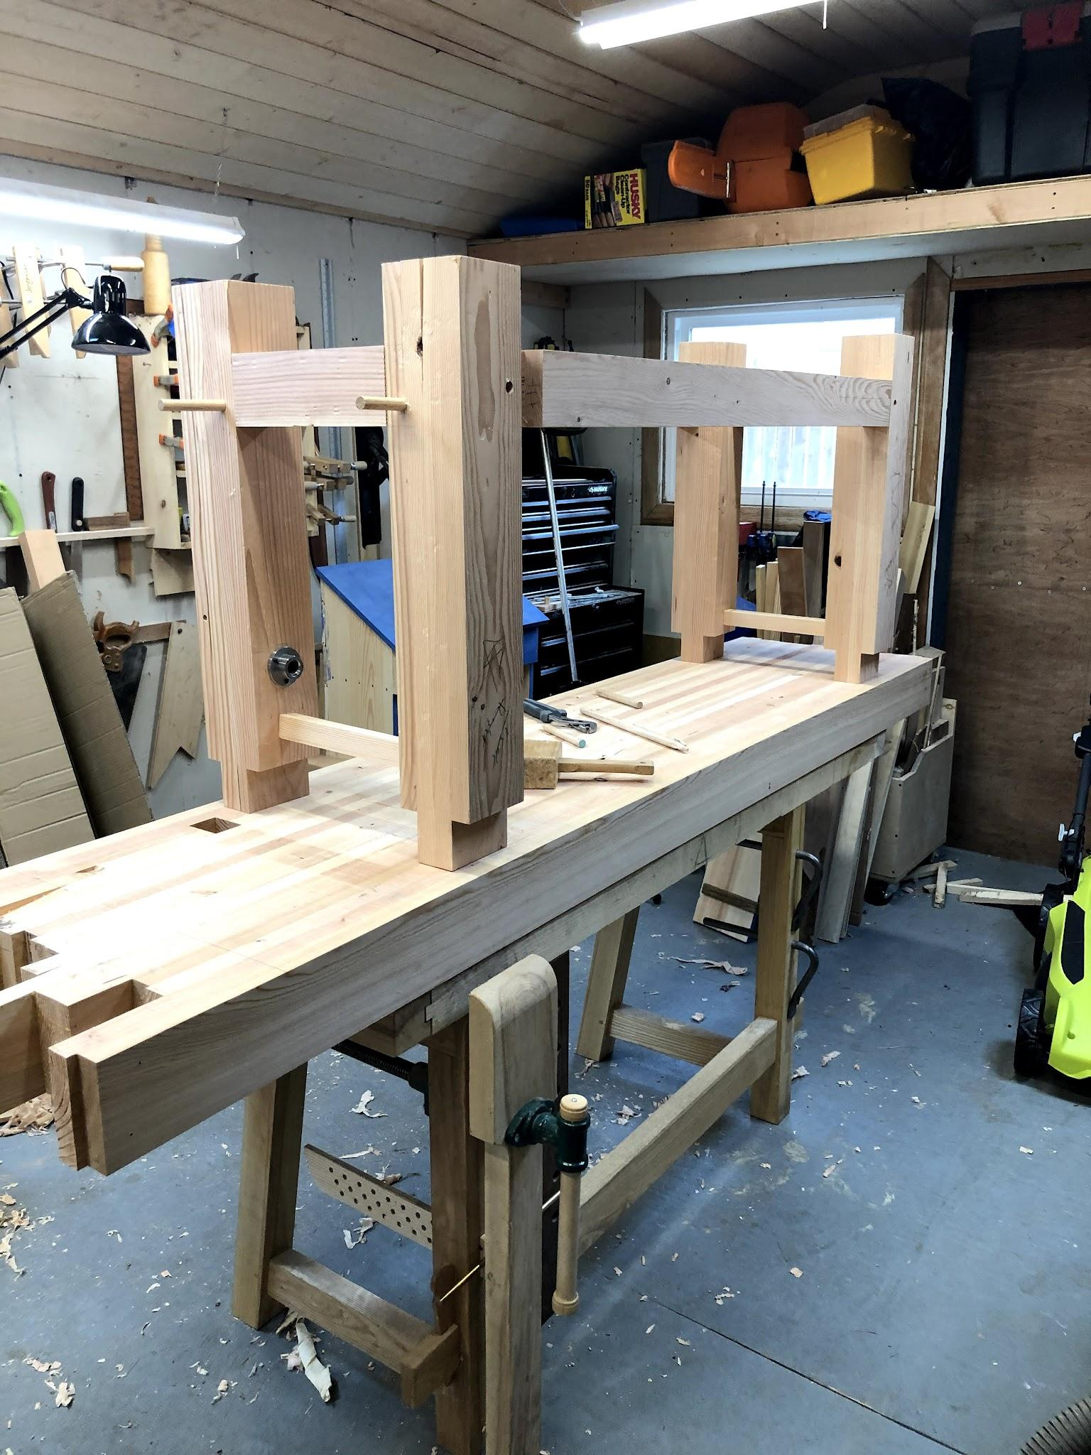
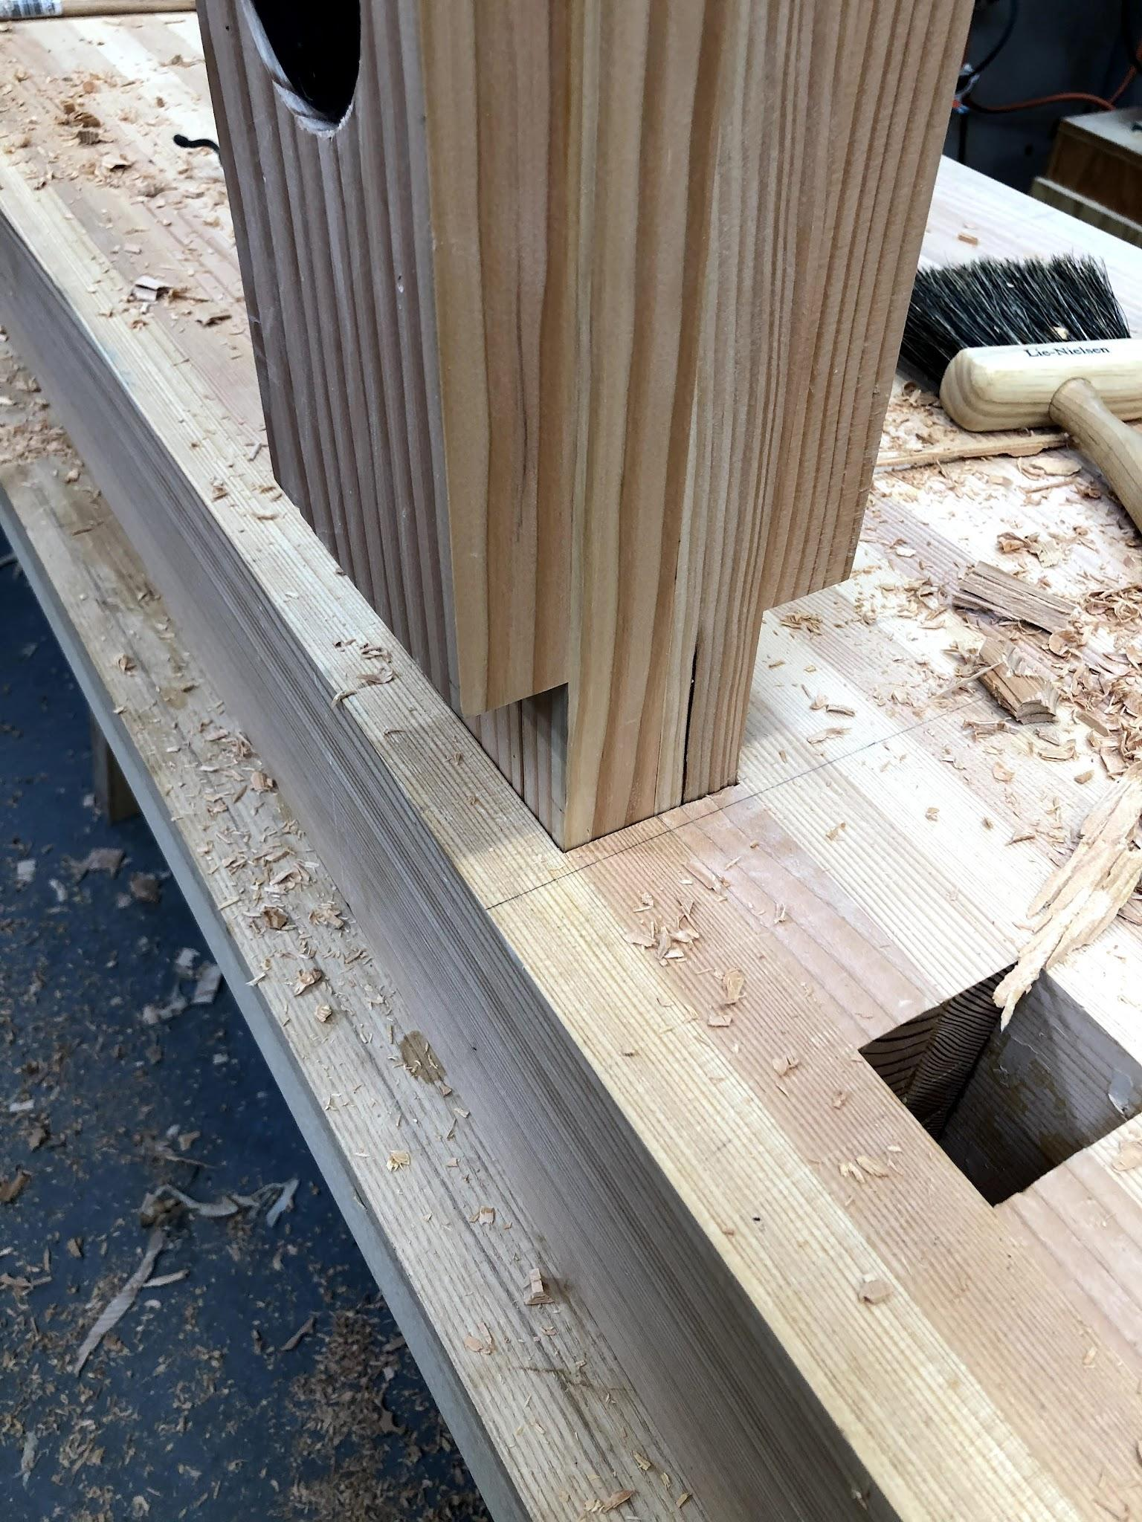

Slide 13
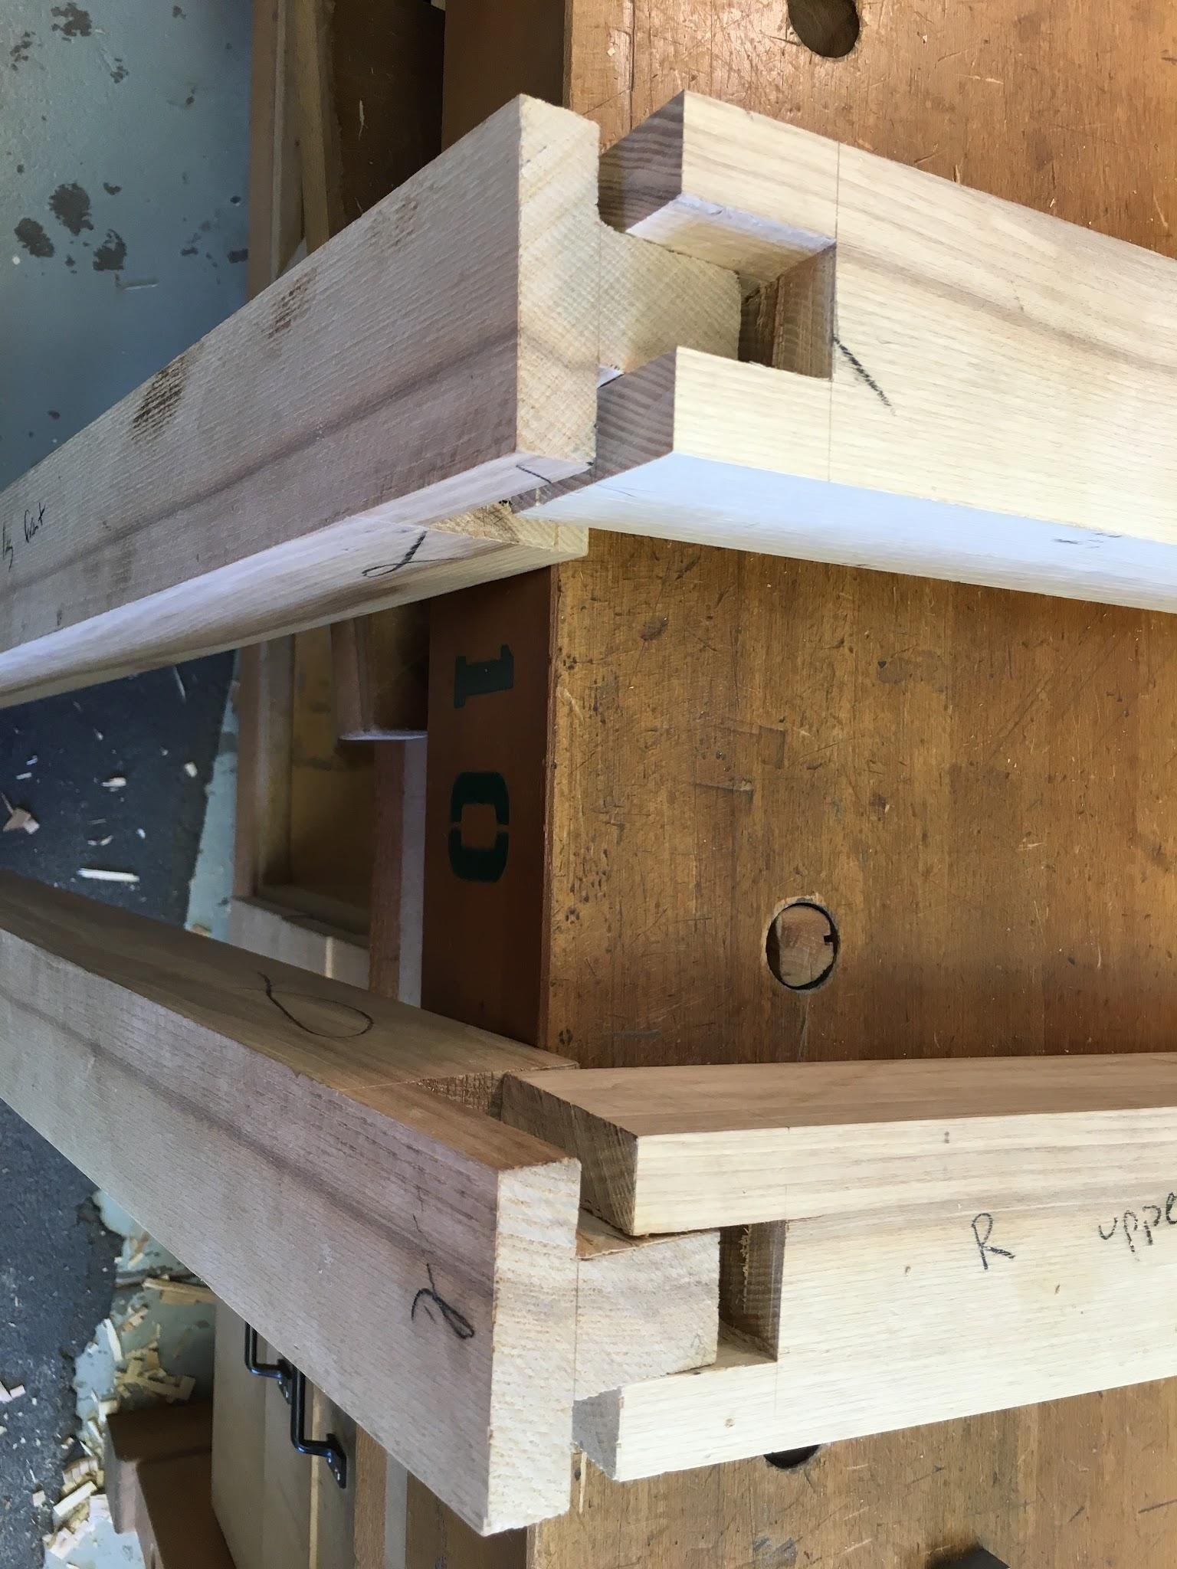
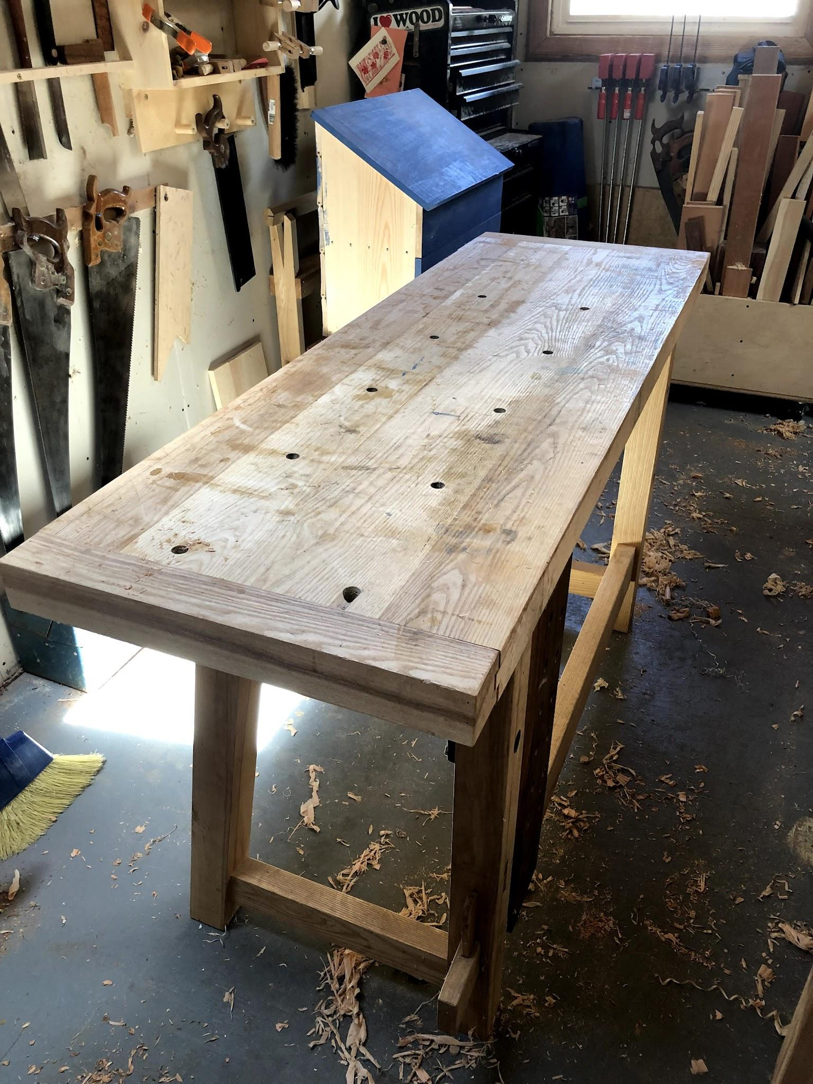

Slide 14
Resources
https://thewoodwhisperer.com/videos/drawbored-mortise-tenon/#:~:text=A%20drawbored%20mortise%20%26%20tenon%20joint,doesn't%20even%20require%20glue!
https://blog.lostartpress.com/2021/10/05/about-drawboring/
https://www.youtube.com/watch?v=iblkJnlmg4w

