Slide 1
A Survey of Finishing Wood
Common Stains, Finishers, and Sealers
By Cody Hanson for the Olympia Woodworkers Guild December 2023

Slide 2
Pantheon of Finishing
Natural – Anything grown in nature, refined for use Synthetic – Anything derived from a lab Stains – Things that change your mediums’ color Finishers – Things that protect the surface, but don’t seal pores Sealers – Things that protect the surface/seal pores Mixers – Things that thin one item or mix multiple items

Slide 3
Naturals: Stains/Finishers/Sealers

Slide 4
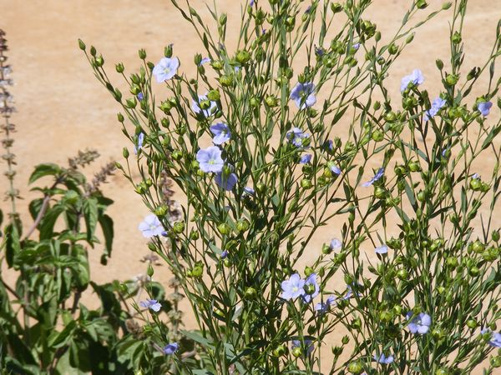
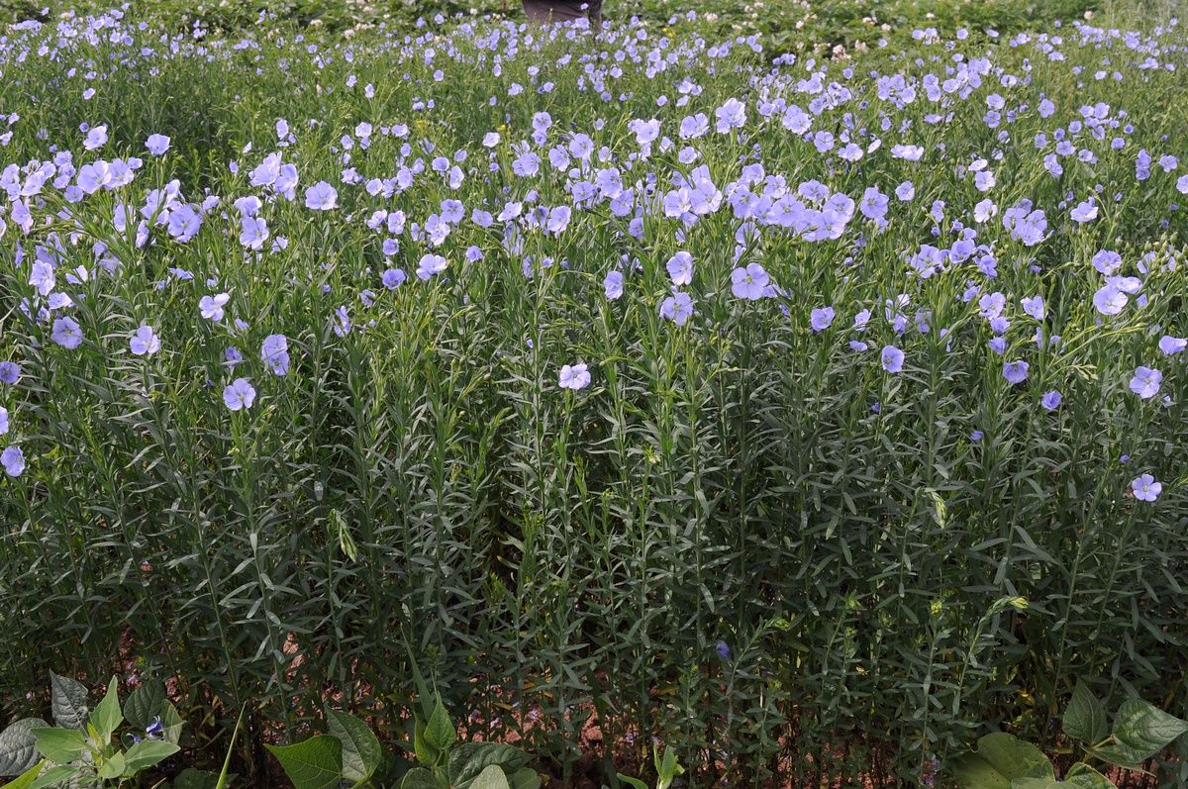
Linseed Oil
Linum Usitatissimum
Previously called Linum or Linus, now called Flax

Slide 5
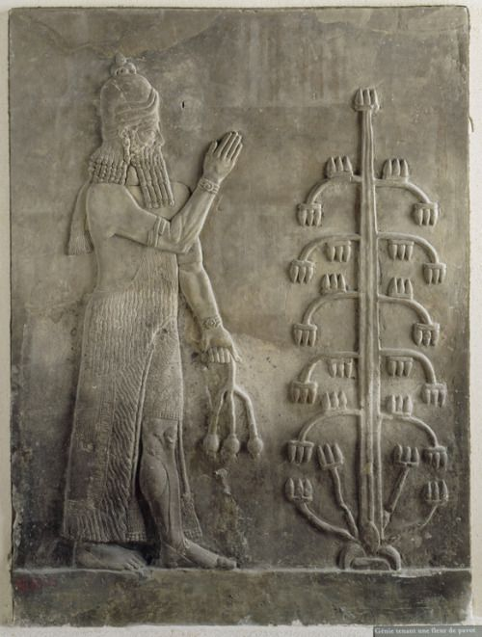
Linseed Oil
Linseed cultivation confirmed as early as 9000 years ago (7000 BC)
First documented in Ancient Sumeria 5900 BC
Used as an additive to cereals, for sealing wood, and oiling metals.

Slide 6
Linseed Oil
Key ingredient in paints, putty's, glazes, wood sealers, animal feed, leather treatment, iron/steel treatment, etc
Active mass production from 5900 BC – 1950s AD, nearly 8000 years. Is a “drying” oil. Is often absorbed by substance and hardens when dried.
Adds a slight yellow taint to wood and can take weeks to feel dry to the touch. Won’t fully cure for months (if you can smell it, it’s not cured)
Notes:
Sumeria wood
Egyptian Paints
Roman Oils
1861 – 1m gallons/year, 1870 – 12m. 1890 – 48m, 1920 – 335m, 1940 – 810m, 1975 – 810m
Additives. Blacking, lead oxide/white lead – tetra ethyl lead
Brush, wipe, spray

Slide 7
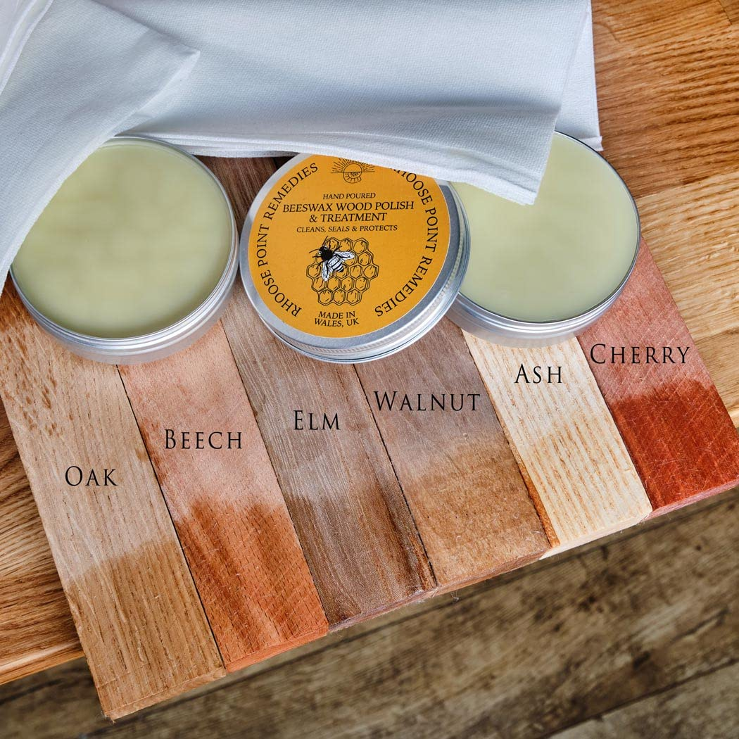
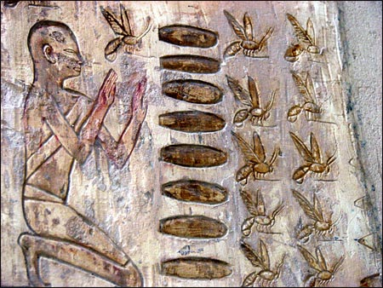
First attested use was in 2650 BC for writing
Candle use first attested 2600 BC
First documented case of Beeswax on wood, 200 BC
Beeswax

Slide 8
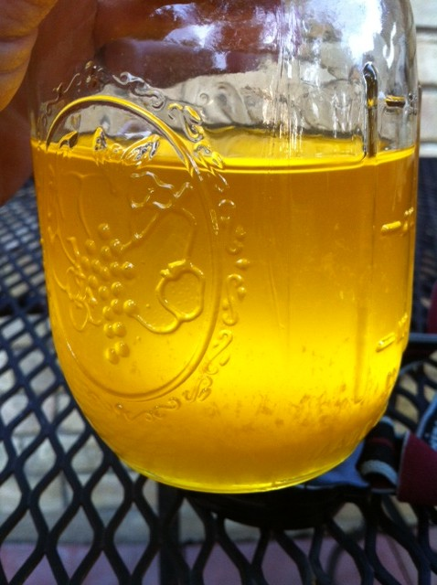
Danish Oil
Mix of Linseed Oil and Beeswax
Gets its name from “Danish” workers hired to do wood and stone work in 7th century Europe, who readily used the mix
Name was revived in the 1950s by Swedish Furniture manufacturers as a marketing name for the distinctive “old world” look.
Traditionally 1 part wax to 3 parts oil
Modern mixes

Slide 9
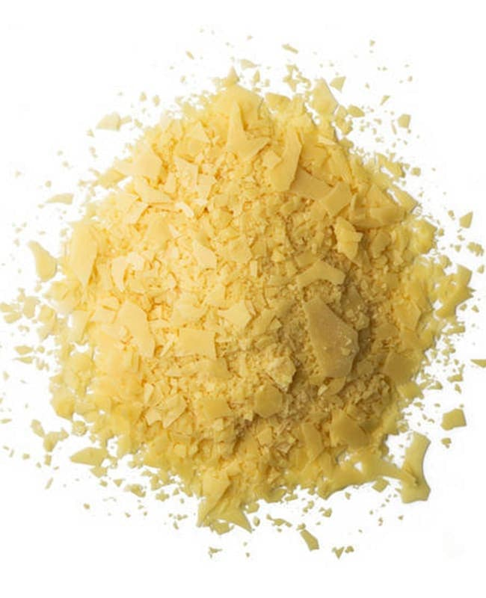
Carnauba Wax
Copernicia Prunifera, Carnauba Palm
Native to Brazil. First used commercially as a wax in the late 1700s
Frequently mixed into beeswax from 1800s on to create a smoother application
Notes:
Glossy vs beeswax matte
Higher melting point
white/ vs yellow
Harder to apply, but longer lasting Mixed in with a lot

Slide 10
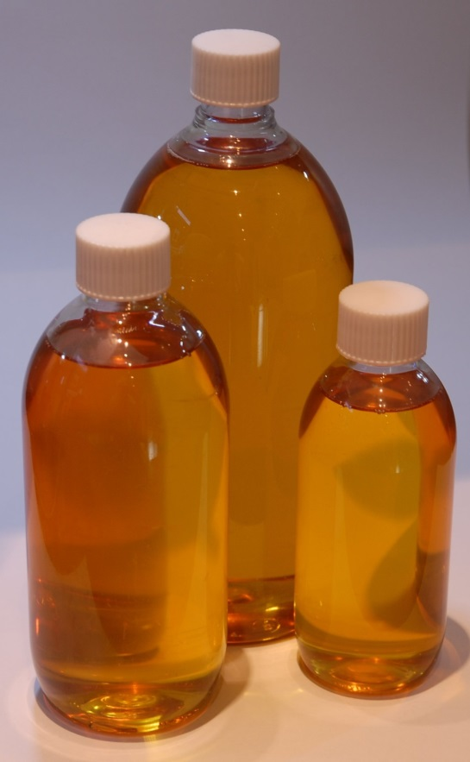
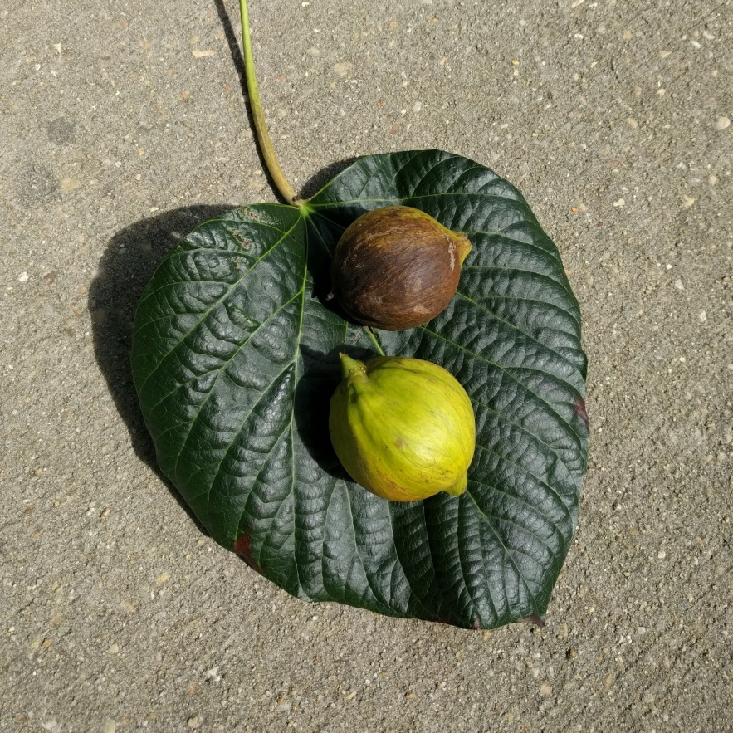
Tung Oil
Vernicia fordii, Tung Tree
First documented 500 BC
Primarily used to seal ships
was discovered by western nations in 1642
Often mixed with Linseed Oil
Still used for boats and outdoor furniture
Modern mixes
Notes:
Modern polyurethane mixes
Brush, don’t wipe.
Can thin

Slide 11
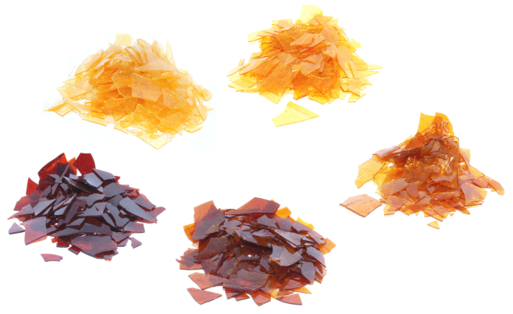
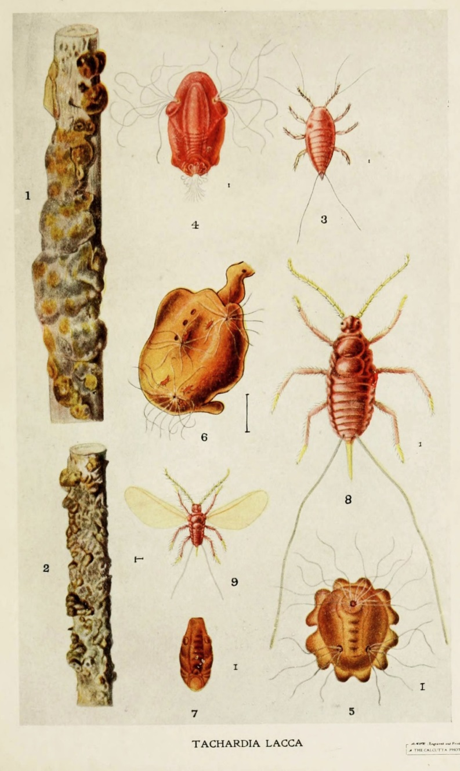
Shellac
Literally She – Lac. Wax substance produced by the female Lac beetle as it eats the Kusum tree (Schleichera oleosa)
Dissolves in alcohol
Most recently application merges with each previous application

Slide 12
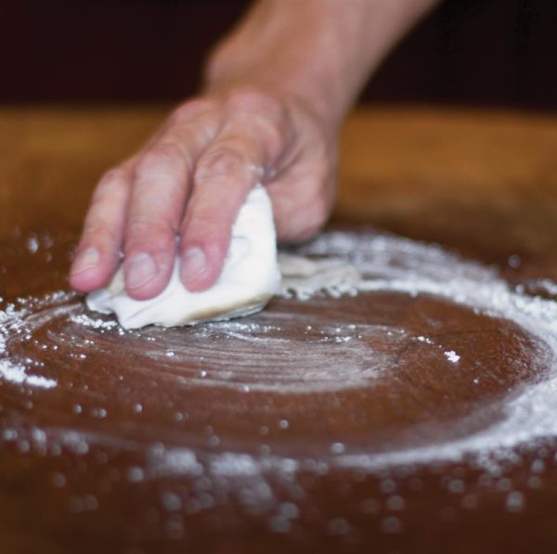
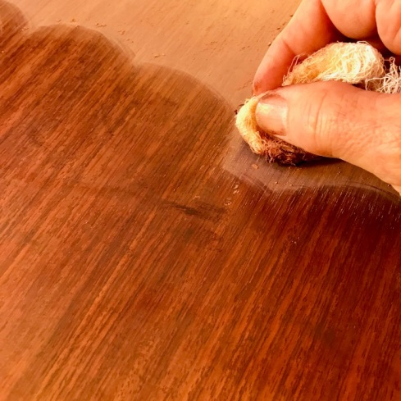
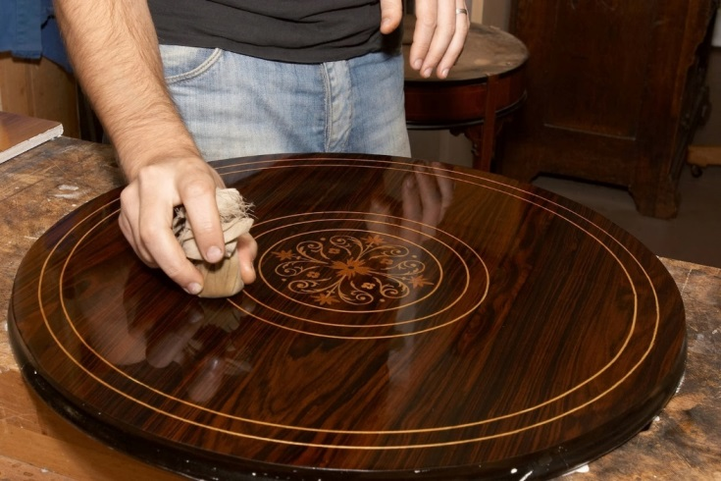
Shellac: Fine Furniture
French Polish: Linen + ground pumice + shellac
Two Methods:
French – soak the linen + pumice in shellac, apply. Repeat 8-10 times
English – apply shellac, then sand with linen + pumice. Repeat 8-10 times

Slide 13
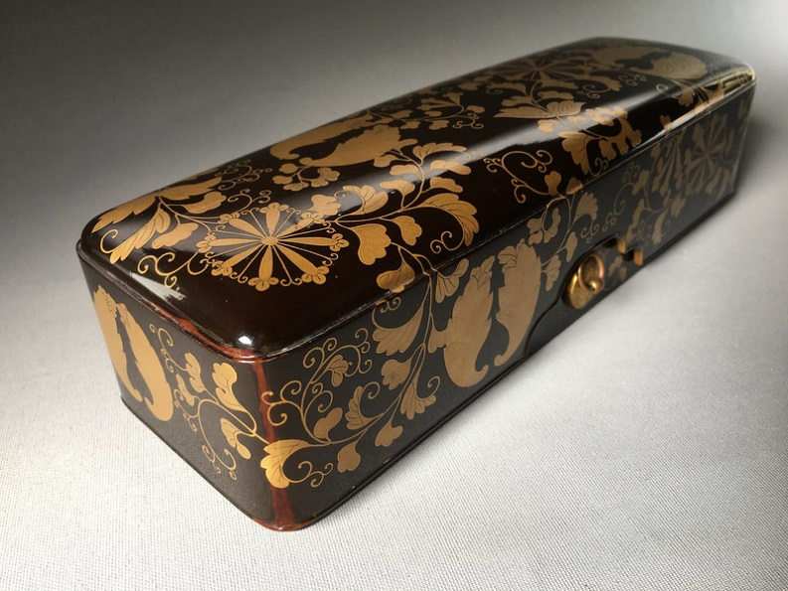
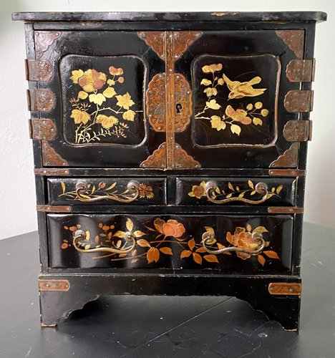
Lacquer: Eastern
Distilled sap of the Toxicodendron vernicifluum, the Lacquer tree
Present in Japan 12,000 years ago
Multiple types
Unrefined is 25% water, Brown
In its refined state is clear
Japanese name changes based on the dye added to it
Linseed oil sometimes added for sheen
NOT JAPPANING

Slide 14
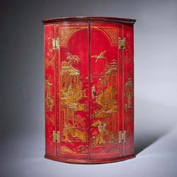
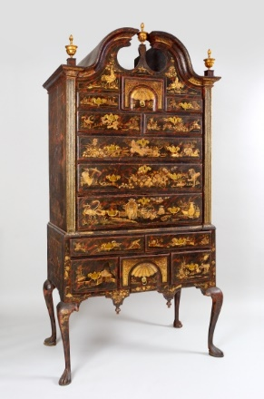
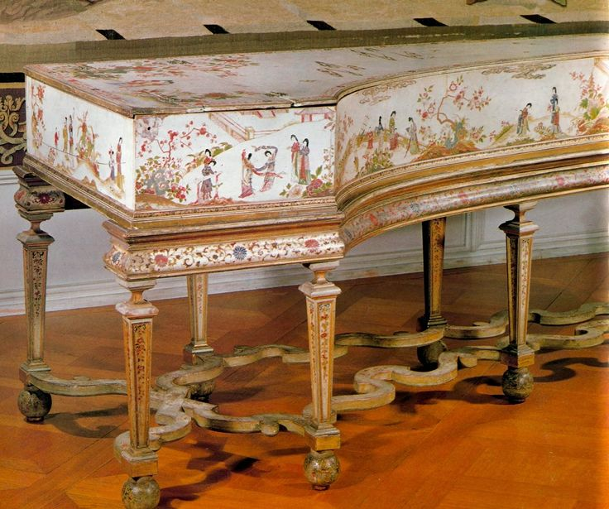
Lacquer: Western
Is a Shellac based product (thus the name)
First appears in the 1600s
Resins dissolved in alcohol create color bases
Mix into shellac, add pine resin, add turpentine
Shake

Slide 15
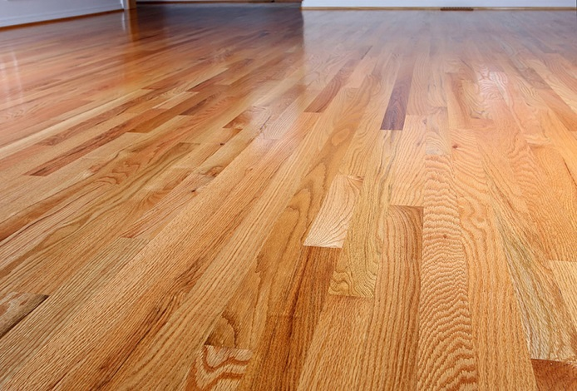
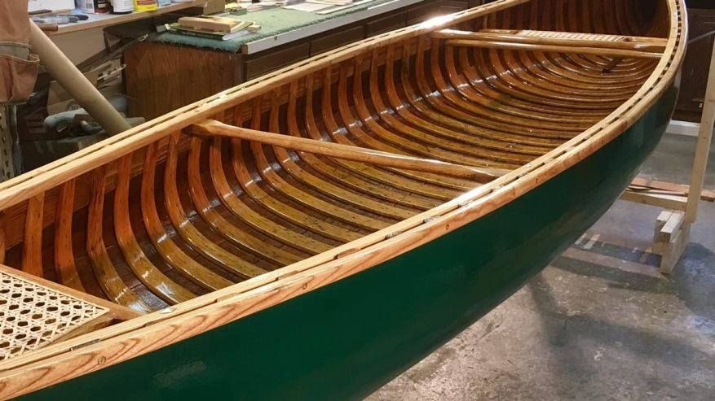
Varnish
From the Latin – Vernix, meaning “foul smelling resin’’
1 Part drying oil + 1 part resin + 1 part solvent
Most common recipe, Linseed oil, Pine Sap, Turpentine
In use from Ancient times to 1950s
Boats, clothing, floors

Slide 16
Naturals: Stains

Slide 17
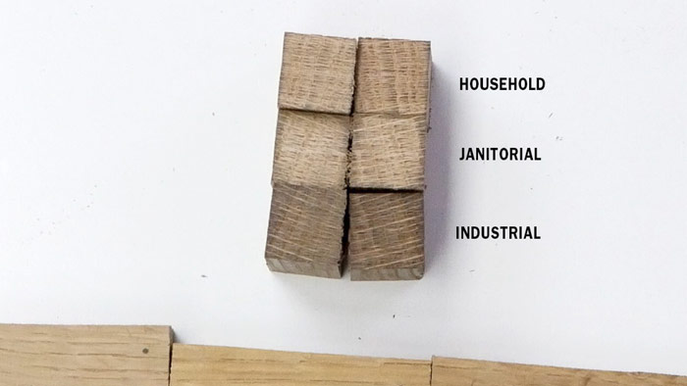
Ammonia Hydroxide
Used for “Fuming”, not application
Reacts to Tannins in wood
Notes:
Quertannic acid – Tannin
Oak, maple, spruce, larch, mahogany,chestnut, elm,
% varies.

Slide 18
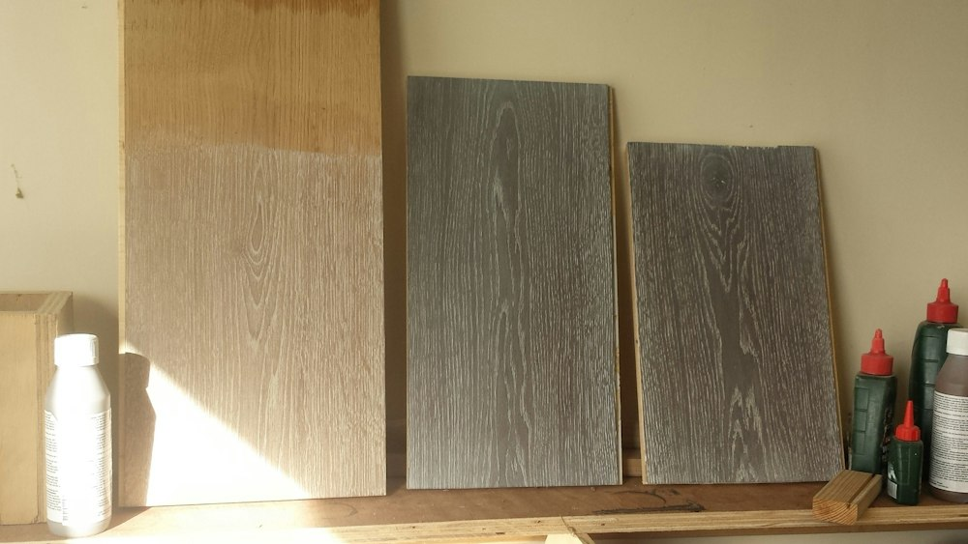
Sodium Hydroxide
Lye
Reacts to Tannins
Ages wood

Slide 19
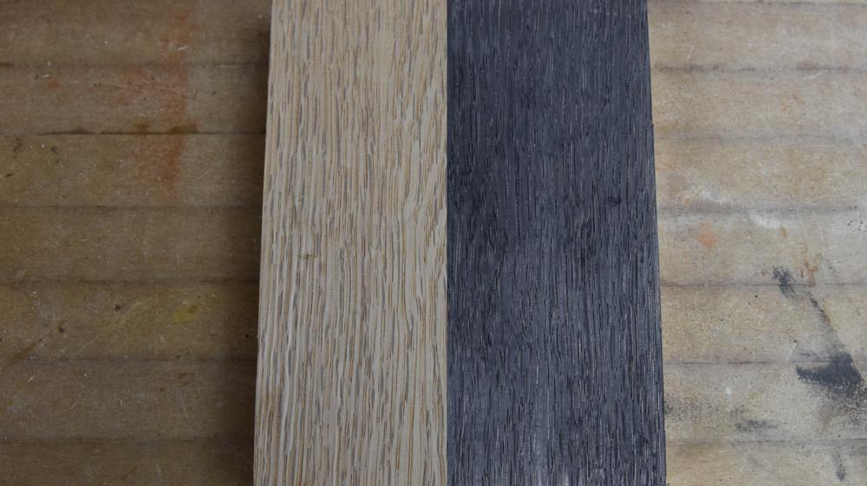
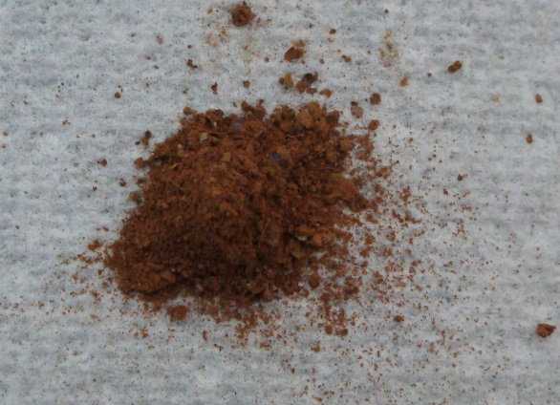
Iron Acetate
Buff Iron
Reacts to Tannins
Rusted Iron in water, mixed to a 50:50 solution with vinegar
Turns Solid black

Slide 20
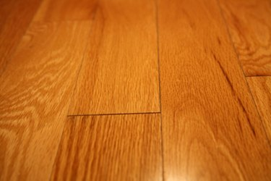
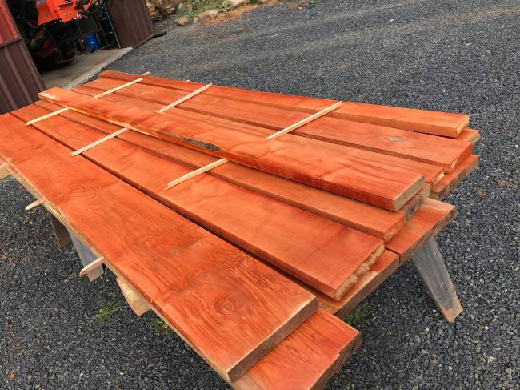
Sodium Borate
Borax
Prevents Mold
Prevents boring insects

Slide 21
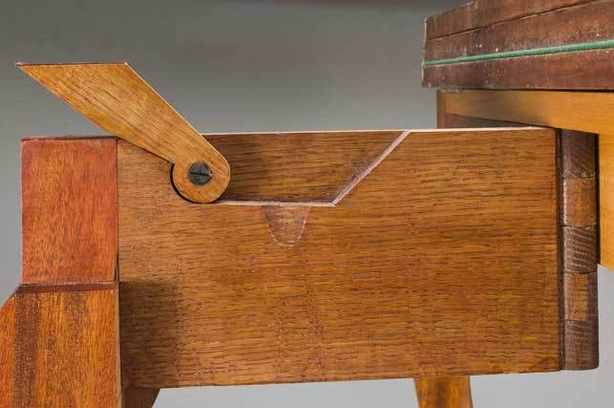
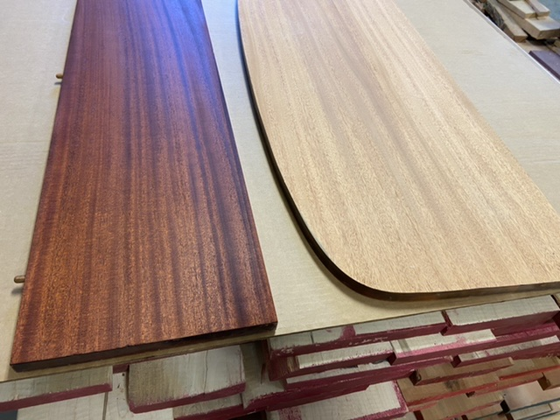
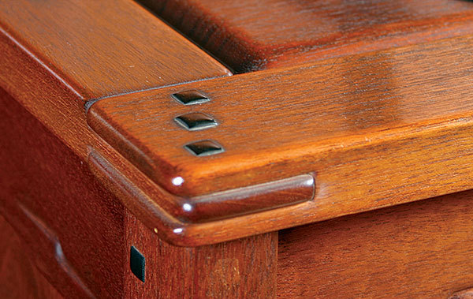
Potassium Dichromate
Extremely Toxic to touch and smell.
Used originally for “Tanning”, leathers, wood, printing, and film.
Ceramics Glazing

Slide 22
Naturals: Solvents

Slide 23
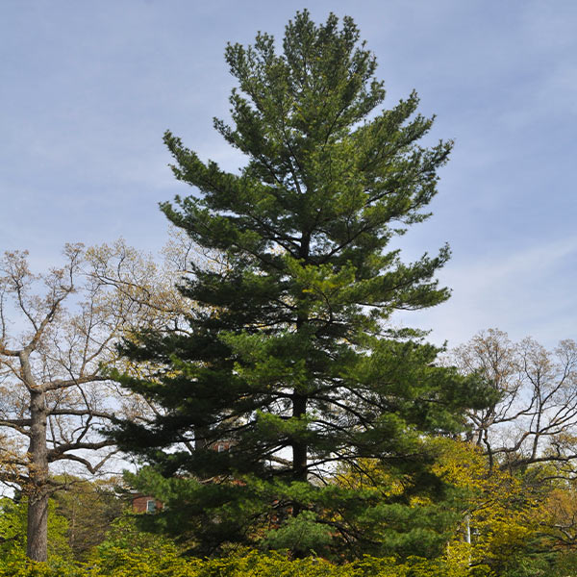
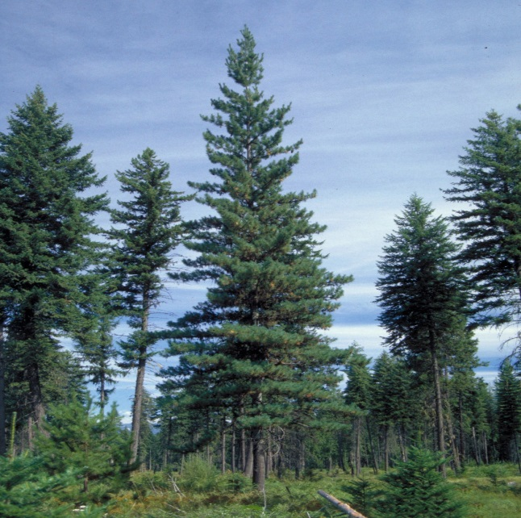
Turpentine
From the Greek Terebinthine - “resin”
Orginally used the Terebinth tree, but moved to Pine.
In the US, Eastern White Pine then Western White Pine
Used in EVERYTHING
Notes:
Toxic
Bio Solvent
Pine sap, distilled into liquid.

Slide 24
Synthetics: Solvents

Slide 25
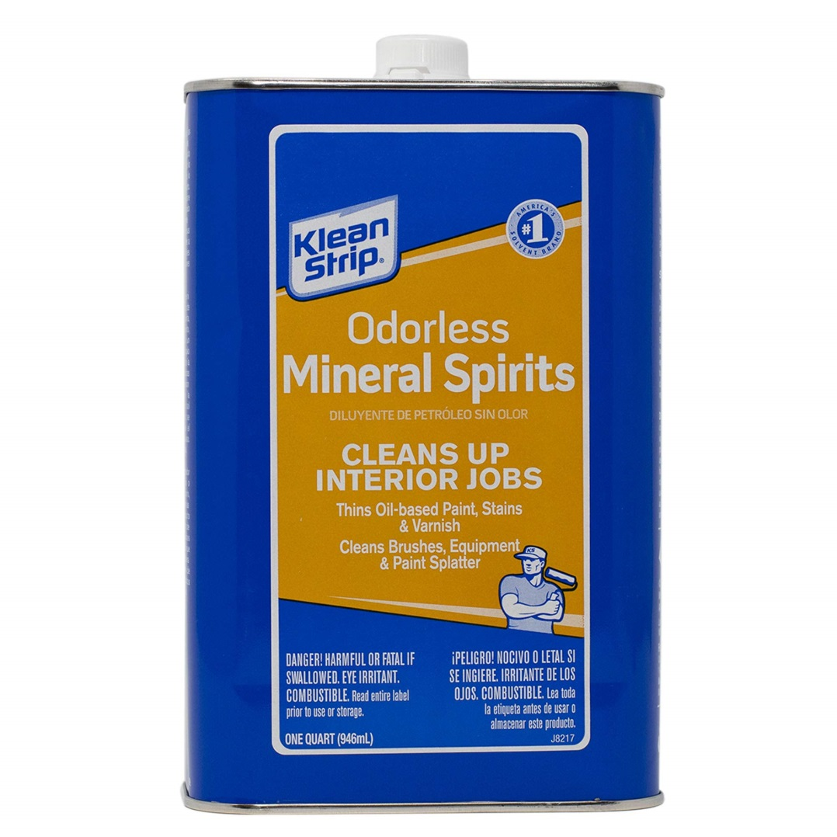
False Turpentine
Oil Solvent
Chemically complicated or 1 step from Diesel
Became known as White Spirits, Petroleum Spirits, or Mineral Spirits

Slide 26
Synthetics: Dyes

Slide 27
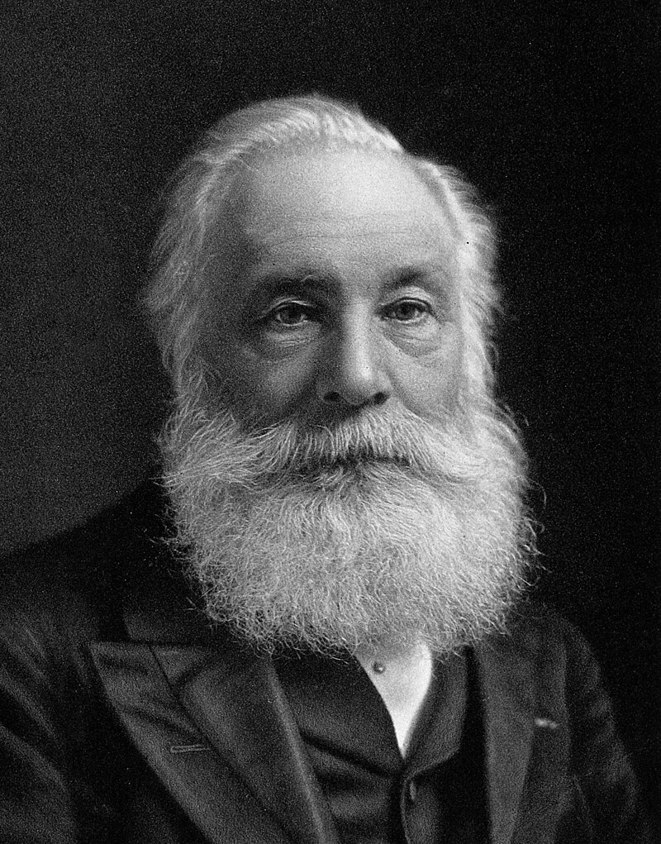
Aniline
William Henry Perkin
At age 18, 1856 made his discovery while looking for a synthetic cure to Malaria.
Notes:
Mauvine

Slide 28
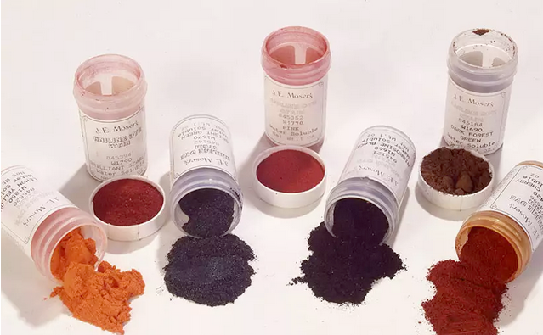
Aniline Wood Dyes
Generally refers to dried powder dyes requiring Oil, Water, or Alcohol to become usable
Notes:
Lee Valley Dyes
W. D. Lockwood Dyes (Tools for woodworking)
J.E. Moser's
Trans Tint

Slide 29
Oil Stains/Paints
Traditional Way of staining
Aniline Dye + Linseed Oil Usually includes dyer agents
Really only works on hardwoods
Prefers planned surfaces vs sanded
High VOC, requires near instant cleanup Mineral Spirits
Doesn’t raise the grain

Slide 30
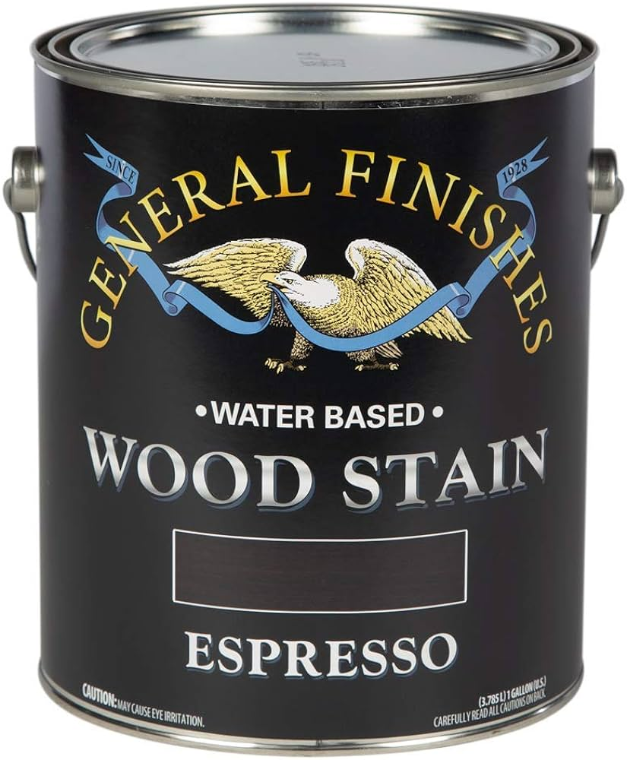
Water Stains
Modern way to stain
Aniline Dye + Water + Evaporating agent
Works on most woods
Low VOC, Easy clean up, wash with water
Prefers sanded surfaces vs planed ones
Raises the grain

Slide 31
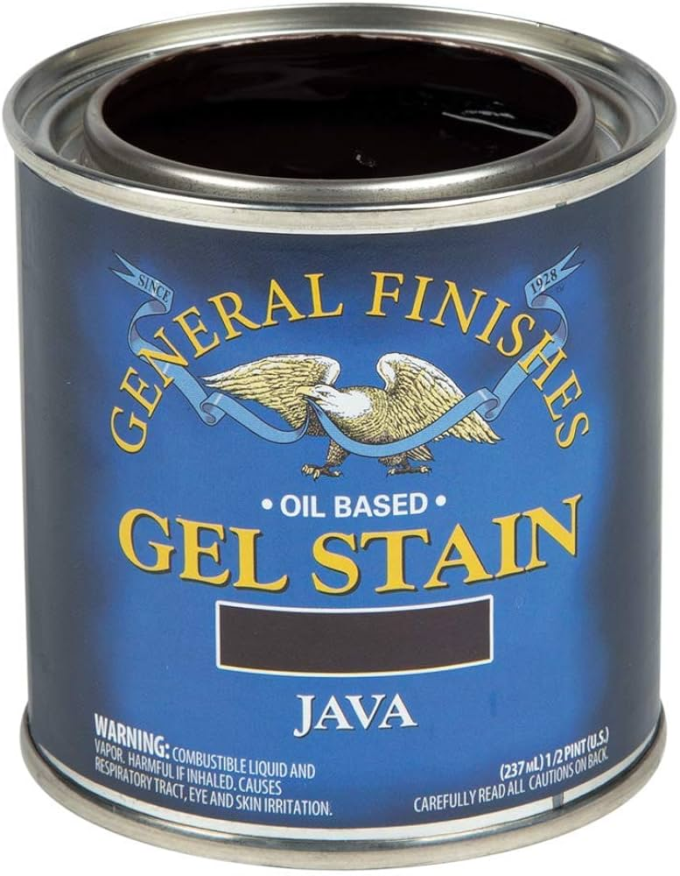
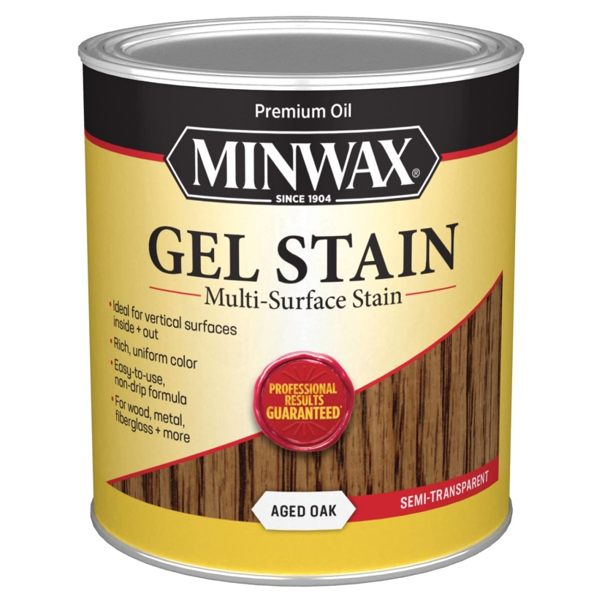
Gel Stains
Invented 1960s
Aniline Dye + Linseed Oil + synthetic jelly + Urethane
Works on all woods, already finished surfaces, non-wood surfaces
Doesn’t raise the grain
Doesn’t blotch, can stain finished woods
Higher VOC than Water based, lower than traditional oil based.
Requires Mineral Spirits for cleaning

Slide 32
Synthetics: Finishers/Sealers

Slide 33
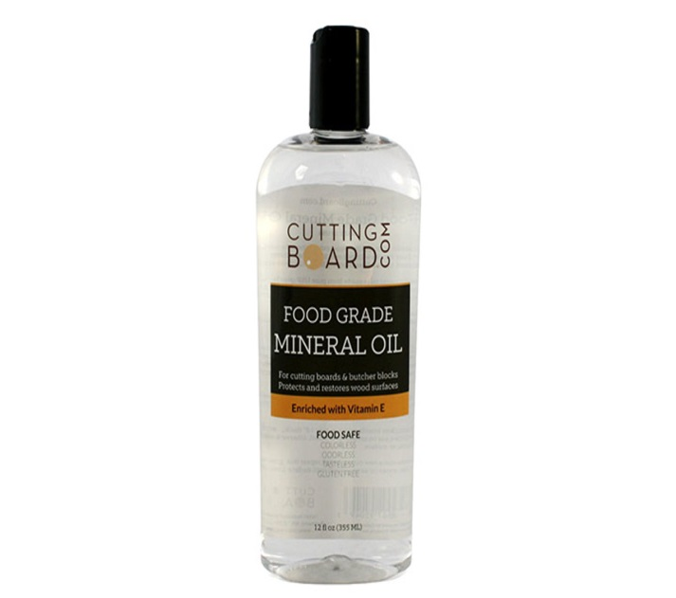
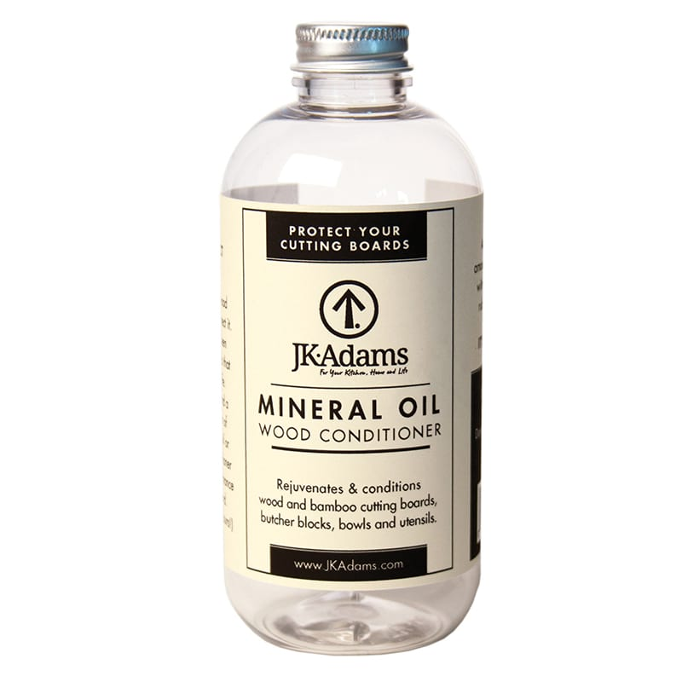
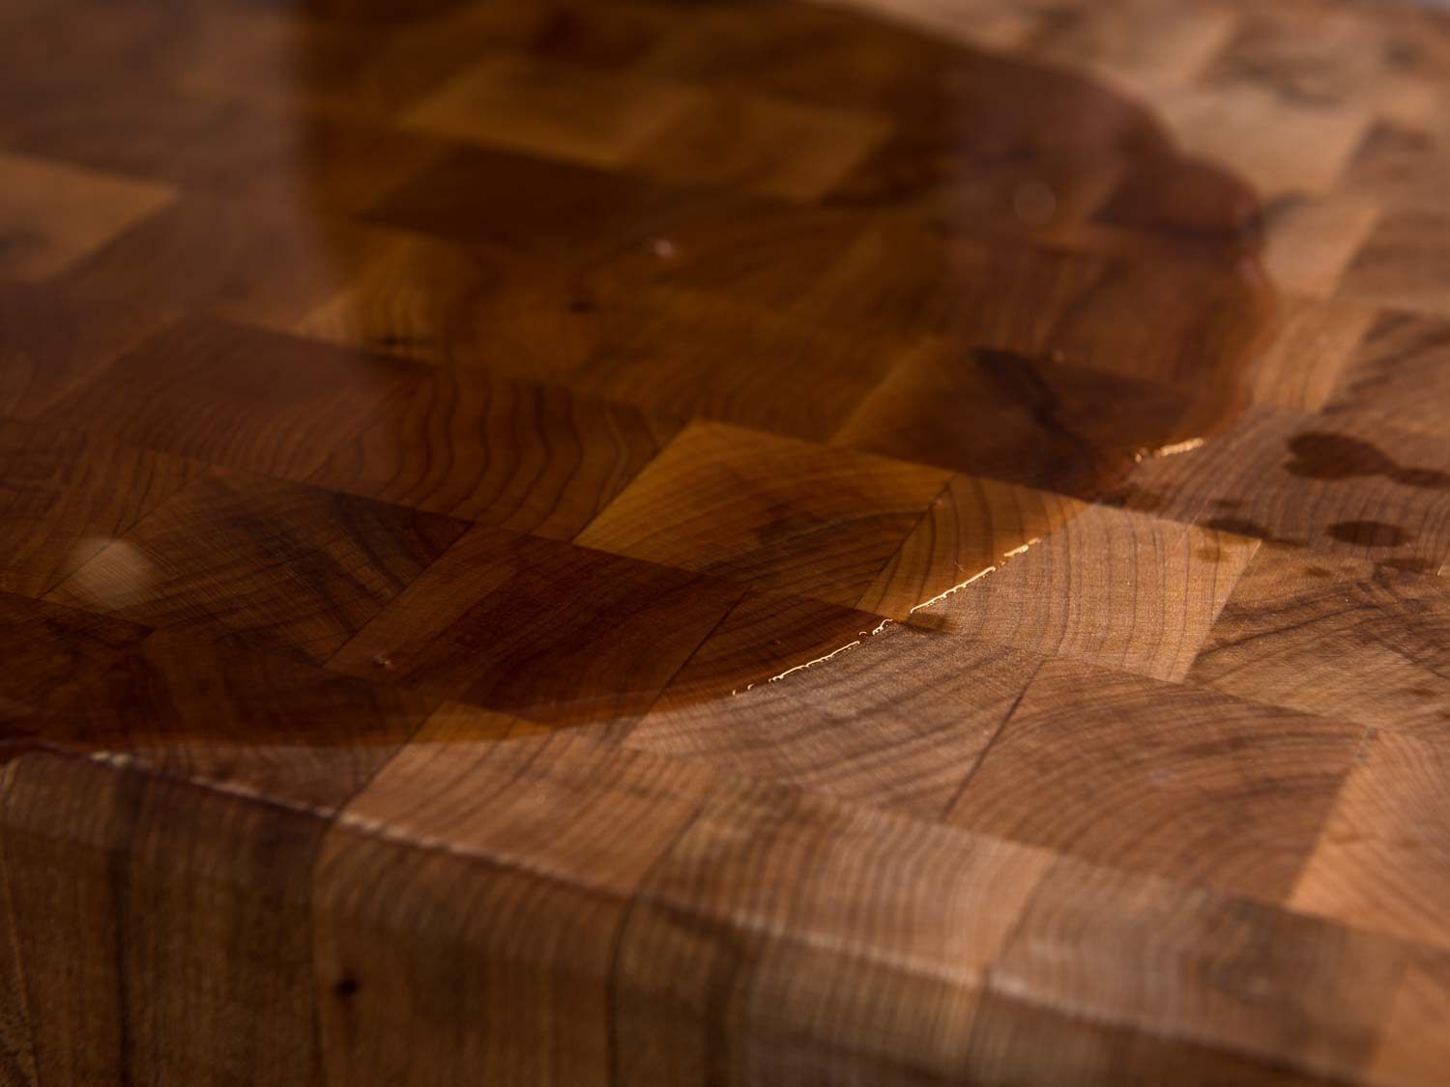
Mineral Oil
Liquid Paraffin or White Oil
Simply liquid Petroleum Jelly

Slide 34
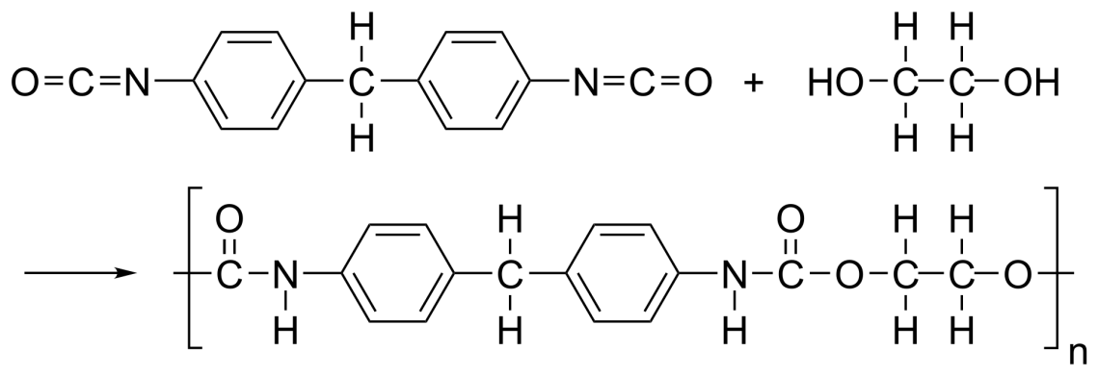
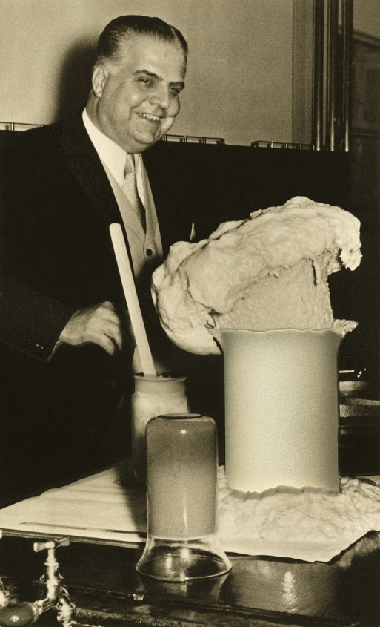
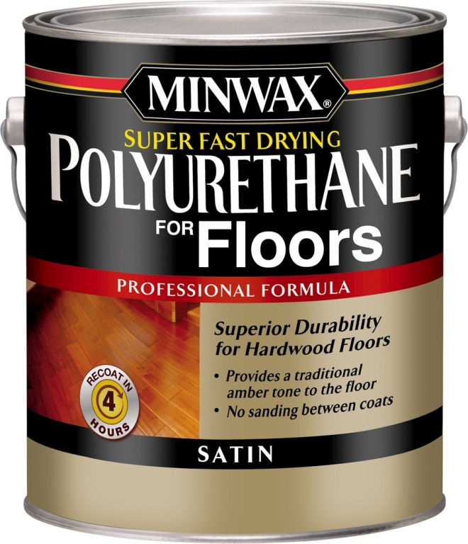
Polyurethane
Discovered 1937 by Otto Bayer, was interrupted and resumed production in 1952
Isocyanate with a Polyol
45k metric tons 1960 -> 25 million metric tons produced annually 2020
Notes:
By 1957 Poly accounted for 55% of wood finishing market

Slide 35
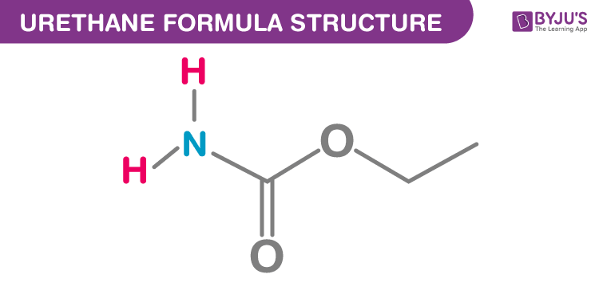
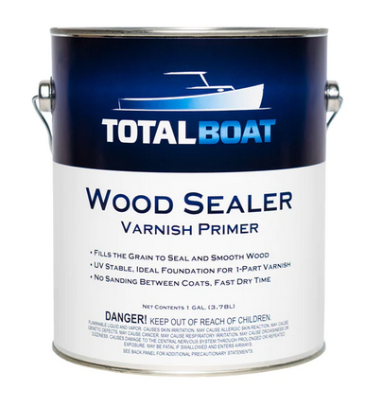
Urethane
Polyisocyanate + Polyol then stripping of the double Poly bond leaving a thin, strong, clear liquid

Slide 36
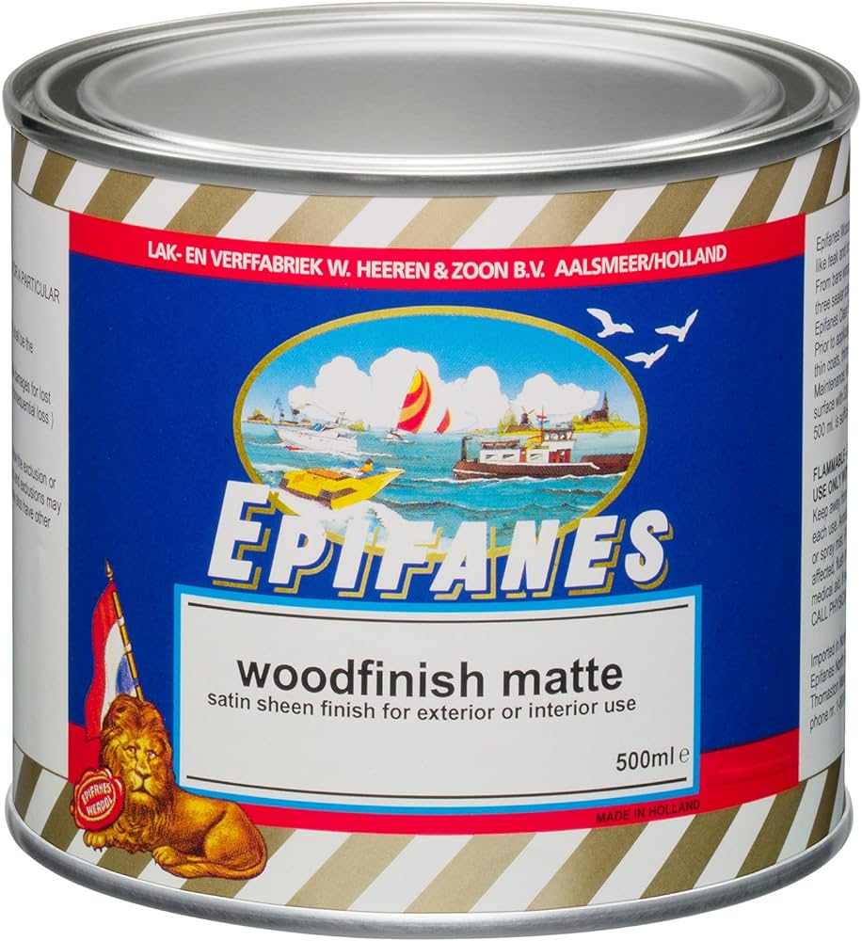
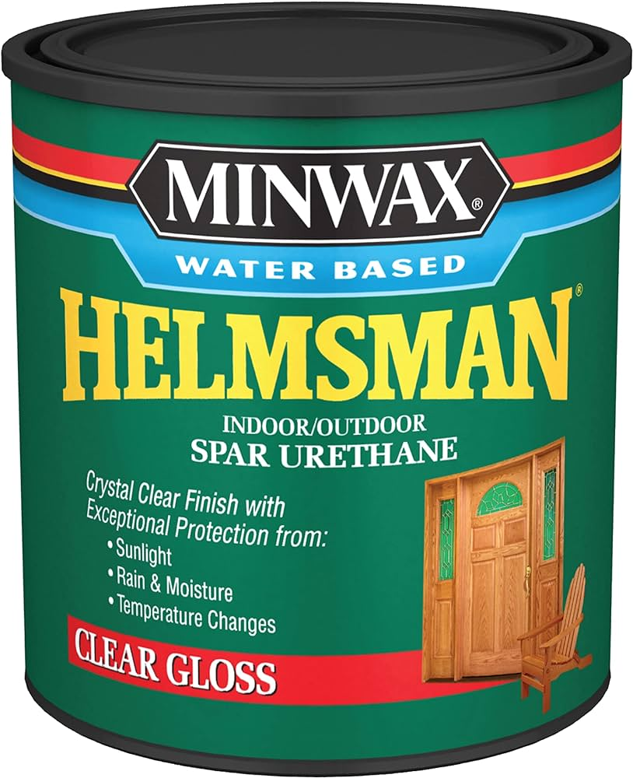
Marine Variants
Urethane with UV protection additives PLUS :
Water Based + evaporators
Linseed Oil Based with dryers
Tung Oil

Slide 37
Thanks!
Comments/Questions?

